Slide 1


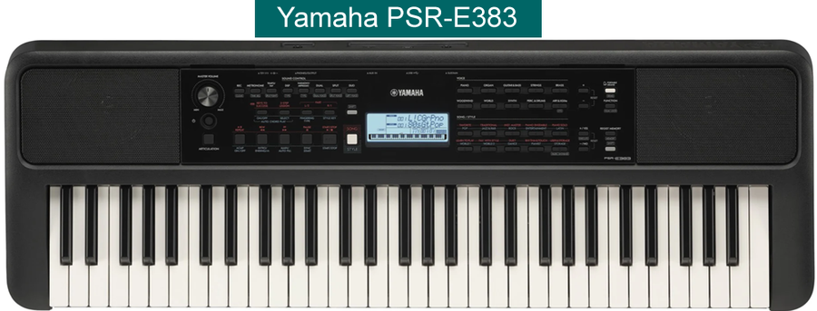

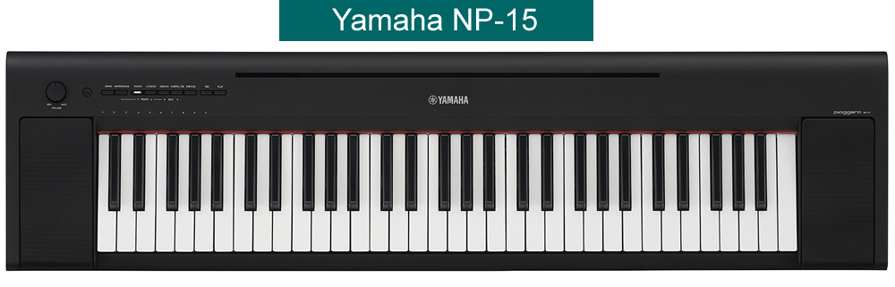
Keyboard
Beginners
Your music journey
starts now!!
Prerequisites:
None
Exercise Workbook:
Adult Piano Adventures All-in-One Book 1
by Nancy & Randall Faber
(Available on Amazon or from music stores)
Website:
www.davebstevens.com/keyboard

Slide 2

Welcome to
Keyboard Beginners
New at U3A Manningham
Your Tutor
Dave Stevens
dave@davebstevens.com
Please find somewhere to set up your keyboard
or
share a keyboard with one of your new classmates

Slide 3
Quick Housekeeping
While I quickly take the roll, please check as follows:
Your Phone:
U3A Badge:
Toilets:
Evacuation Point:
Is on silent
Is visible to your new classmates
and note:
Are just outside the classroom; turn left down the corridor,
and they are on your right
In case of an emergency evacuation:
  Go back to reception,
  turn left and exit the building,
  follow the path straight ahead (north) approx. 80m to
“Johns Grove” (street name).

Slide 4
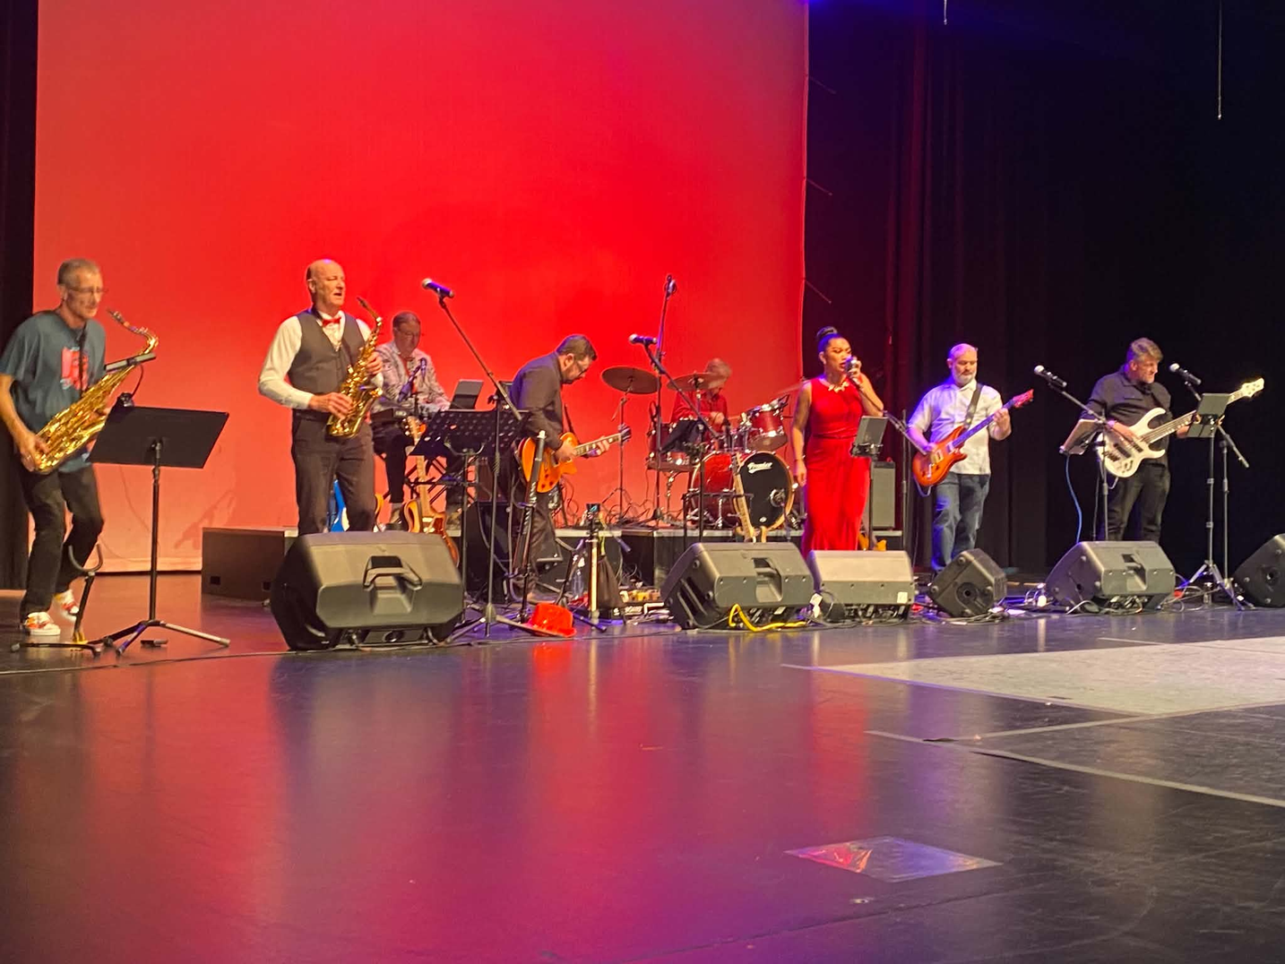
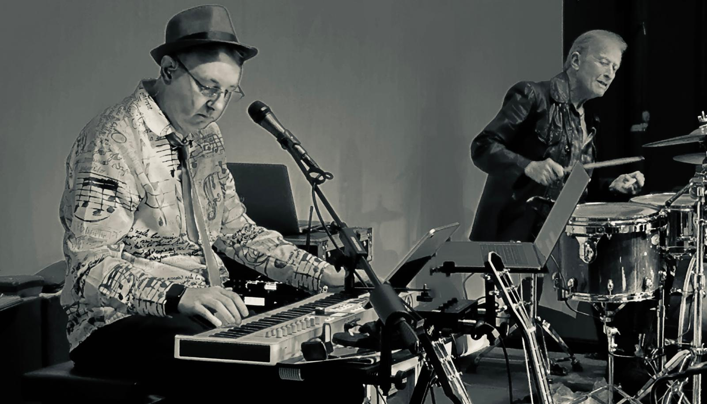
Hi, I’m Dave!
  2023 - Started learning keyboard
  2024 - Joined a jamming group
  2025 - That turned into a band
When I started, I’d never touched an instrument, had no particular musical goals and no special talent.
I was looking for something to do in retirement, and I found my new passion!
Your musical journey
starts today!!

Slide 5
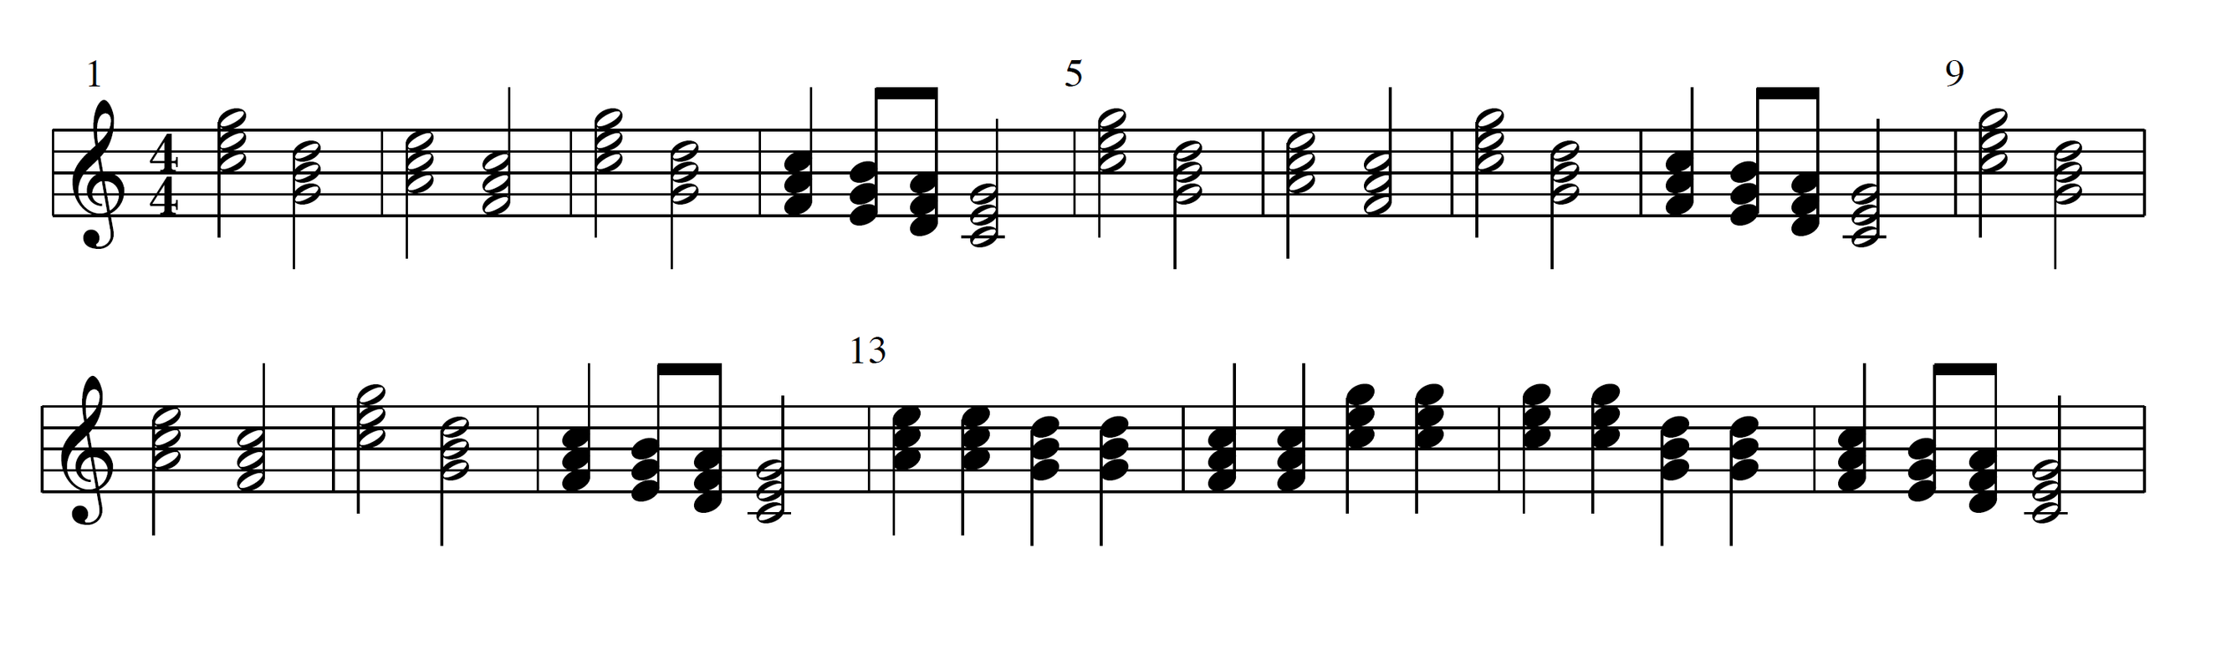

Welcome to your Keyboard Journey
Where Will You Be in 6 Months?
Imagine sitting down at your keyboard in half a year from now and feeling completely at home. You will be able to:
  Play a handful of your favourite tunes
  Understand how chords fit together, and
  Read and play basic sheet music like this:
Instead of just listening to music, you will be
making music! It is a wonderful, rewarding
hobby that will bring a brand-new soundtrack into your home.
The Adventure Ahead
Learning a new instrument is incredibly fun, but it is also a wonderful workout for the brain! There will absolutely be moments of frustration when your left and right hands refuse to cooperate. That is completely normal (at any age). Embracing those little challenges and laughing through the mistakes is all part of the joy that this journey brings.
= 72
Intro
1
Verse 1
Chorus
When I find myself in tiimes of trouble And in my hour of darkness she is
Mother Mary comes to me Speaking words of wisdom
Let it be
standing right in front of me Let it be Leit it be Let it be Let it be Whisper words of wisdom Let it be
Speaking words of wisdom
Let it be

Slide 6
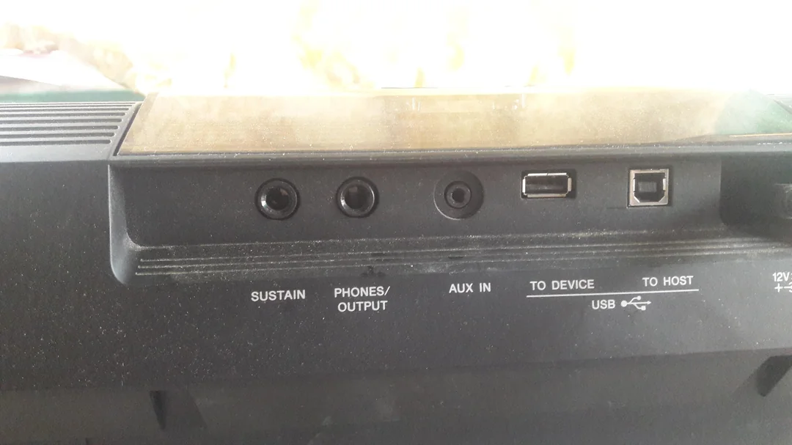

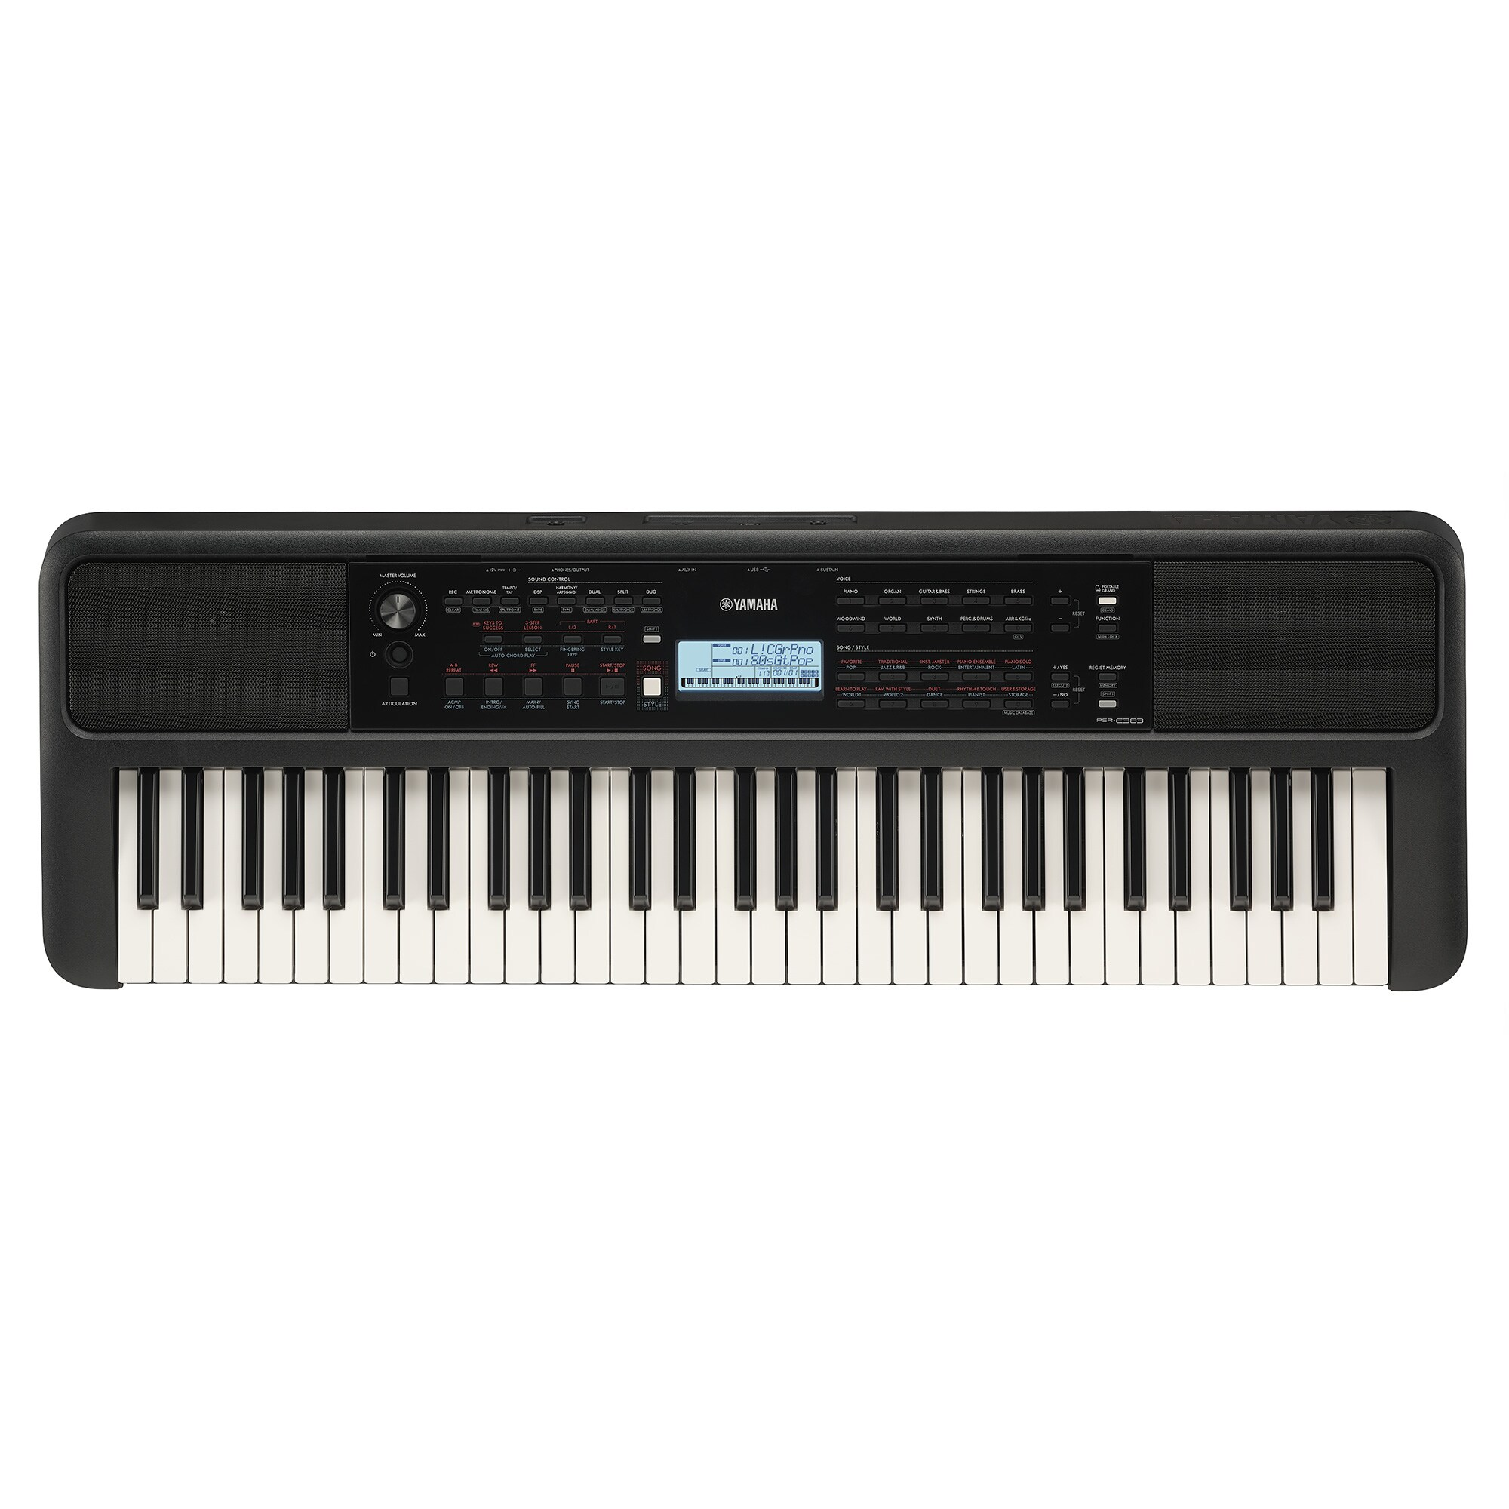
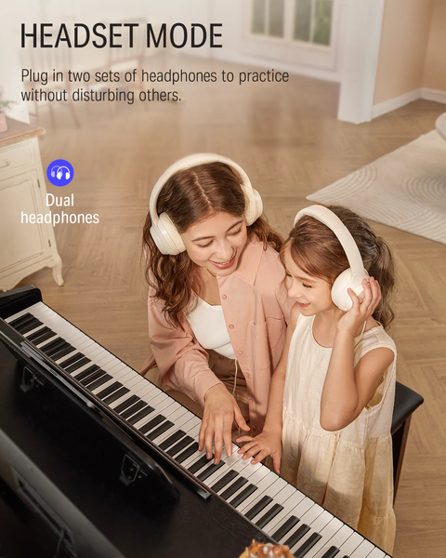
Let’s Get Started
1
Connect your headphones to your keyboard.
Test that you can hear your keyboard when you play. Adjust the volume to suit.
2
Leave one ear uncovered so you can hear me.
3
4
If you are sharing a keyboard, we can loan you a headphone splitter so both of you can hear the keyboard.

Slide 7
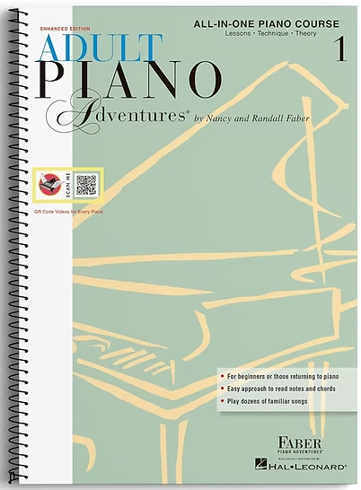
Exercise Workbook
Adult Piano Adventures All-in-One Book 1
by Nancy & Randall Faber
(Available on Amazon or from music stores)
Turn to
Page 8

Slide 8
Practice at Home
Your Secret Weapon: Regular Practice
The key to unlocking your hidden talent is regular, relaxed practice at home.
  No pressure: To start with, just sit down and play whenever the mood strikes you.
  Step-by-step: We will gradually build a gentle, structured practice routine for you.
  Consistency wins: Just a few minutes a day will do absolute wonders for your progress. When you sleep, your brain takes what you’ve learnt and locks it in. So regular short practice is better than occasional long practice.
Some Things To Do This Week
  Practice playing Amazing Grace on pages 12-13.
  Play with the Metronome button on your keyboard and learn how it works. Try setting it to 100 bpm and clap the rhythms on page 14. If you don’t have a Metronome button on your keyboard, download an app for your phone.
  Familiarise yourself with the next 10 pages of the workbook, which we’ll study next lesson.
  If you don’t have a Sustain pedal yet, buy one. Visit www.DaveBStevens.com/keyboard and see the FAQ “What Accessories Must I Have” (towards the bottom of the page).

Slide 9
Lesson 2
Since the last lesson, did you ...
  Practice playing Amazing Grace on pages 12-13?
  Find the Metronome button on your keyboard? (or download a Metronome app for your phone)
  Buy a Sustain pedal?
Any questions that came
up during the week?

Slide 10
Exercise Workbook
Turn to
Page 15

Slide 11
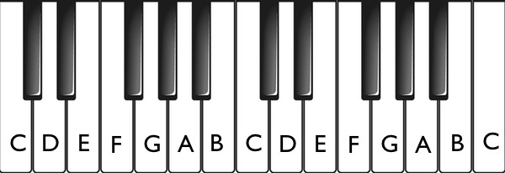
White Key Names
  Keys are given letter names: A, B, C, D, E, F and G.
  A to G are the 7 white keys.
  Below, this pattern is repeated three times. Each repetition has been shaded a different colour.
  Instead of starting at A, the pattern actually starts at C. It then proceeds to the right with D, E, F, G and then loops around to A, B again (to finish the 7 keys).
  On your 61-key keyboard, this pattern is repeated a total of 5 times.
  Each repetition is called an Octave.

Slide 12
Let’s zoom in on a single Octave (the 7 white notes starting at C).
Group of
2 black keys
(“Chopsticks”)
Group of
3 black keys
(“Fork”)
  Every Octave (the repeating pattern) includes one group of two black keys and one group of three black keys.
  We use these groups of black keys to locate the white note that we are looking for.
  Think of the 2 black keys as “Chopsticks” because chopsticks come in twos.
  Think of the 3 black keys as a “Fork” because a fork has three tines (or prongs).
  The key called C is always just to the left of the “Chopsticks”.
  The key called F is always just to the left of the “Fork”.

Slide 13
Octaves are numbered from left to right. Middle C is always C4.
C3
C4
C5
Middle C
(the C nearest to the middle of the keyboard)
Treble notes
Bass notes
As we move up the keyboard, to the right of Middle C, the sounds become higher. These are the Treble notes and are typically played with the right hand.
Moving down the keyboard, to the left of Middle C, the sounds become lower. These are the Bass notes and are typically played with the left hand.
Middle C may be a Bass note or a Treble note.

Slide 14
Below is a 61-key keyboard with the octaves marked:
C2
C3
C4
C5
C6
C7
Middle C
(the C nearest to the middle of the keyboard)
Treble notes
Bass notes
Exercise:
  Starting at C2, use finger 3 of your L.H. to play each note until you reach middle C (C4). As you play each note, say the letter name in your head.
  Then change to finger 3 of your R.H. and play each note until you reach C7.

Slide 15
C2
C3
C4
C5
C6
C7
Middle C
(the C nearest to the middle of the keyboard)
Exercise:
  Starting at Middle C, play all the C keys on the keyboard down to C2 ...
  ... then play all the C keys up to C7 ...
  ... and then play back to C4.
When below C4 use finger 3 of your L.H. When above C4 use finger 3 of your R.H. You may use either hand to play C4.
Repeat for all the letters on the keyboard. Next do all the Ds, then all the Es, etc until you finish by playing all the Bs.

Slide 16
Exercise Workbook
Back to
Page 16

Slide 17
Practice at Home
Some Things To Do This Week
  Practice Morning on page 15. Slow and accurate until you stop making mistakes (might take many practice sessions and that’s normal), then speed up to the correct pace for the song.
  Practice Merrily We Roll Along on page 19.
  Familiarise yourself with the next 10 pages of the workbook, which we’ll study next lesson.
  If you don’t have a Sustain pedal yet, buy one. Visit www.DaveBStevens.com/keyboard and see the FAQ “What Accessories Must I Have” (towards the bottom of the page).
  If you are practicing for more than 15 minutes at a time, check out the FAQ video “Should I Warm Up My Hands Before Playing?” which shows a “5 Minute Routine to Help Piano Players Prevent Injury”
Your Secret Weapon: Regular Practice
The key to unlocking your hidden talent is regular, relaxed practice at home.
  No pressure: To start with, just sit down and play whenever the mood strikes you.
  Step-by-step: We will gradually build a gentle, structured practice routine for you.
  Consistency wins: Just a few minutes a day will do absolute wonders for your progress. When you sleep, your brain takes what you’ve learnt and locks it in. So regular short practice is better than occasional long practice.

Slide 18
Lesson 3
Since the last lesson, did you ...
  Practice Morning?
  Practice Merrily We Roll Along?
  Buy a Sustain pedal?
  Watch the video - “5 Minute Routine to Help Piano Players Prevent Injury”?
Any questions that came
up during the week?

Slide 19
Exercise Workbook
Back to
Page 20

Slide 20
Practice at Home
Some Things To Do This Week
  Practice C Pentascale Warm-up on page 22.
  Practice Warm-up with 3rds on page 23.
  Practice Ode to Joy on page 24-25. Start slow and speed up as you become familiar with it.
  Familiarise yourself with the next 6-7 pages of the workbook, which we’ll study next lesson.
Your Secret Weapon: Regular Practice
Each time you practice this week - play 1 and 2 above to warm up your fingers before working on Ode to Joy.
And if you play for more than 15 minutes, or if you experience discomfort, do the warm-up exercises from this video.

Slide 21
Lesson 4
Since the last lesson, did you ...
  Practice C Pentascale Warm-up on page 22?
  Practice Warm-up with 3rds on page 23?
  Practice Ode to Joy on page 24-25? Did you start slow and speed up as you become familiar with it? Did you play hands separately, slowly and then try playing hands together? It’s tricky. But not to worry, as you’ll be able to do it with practice.
Any questions that came
up during the week?

Slide 22
Exercise Workbook
Back to
Page 26

Slide 23
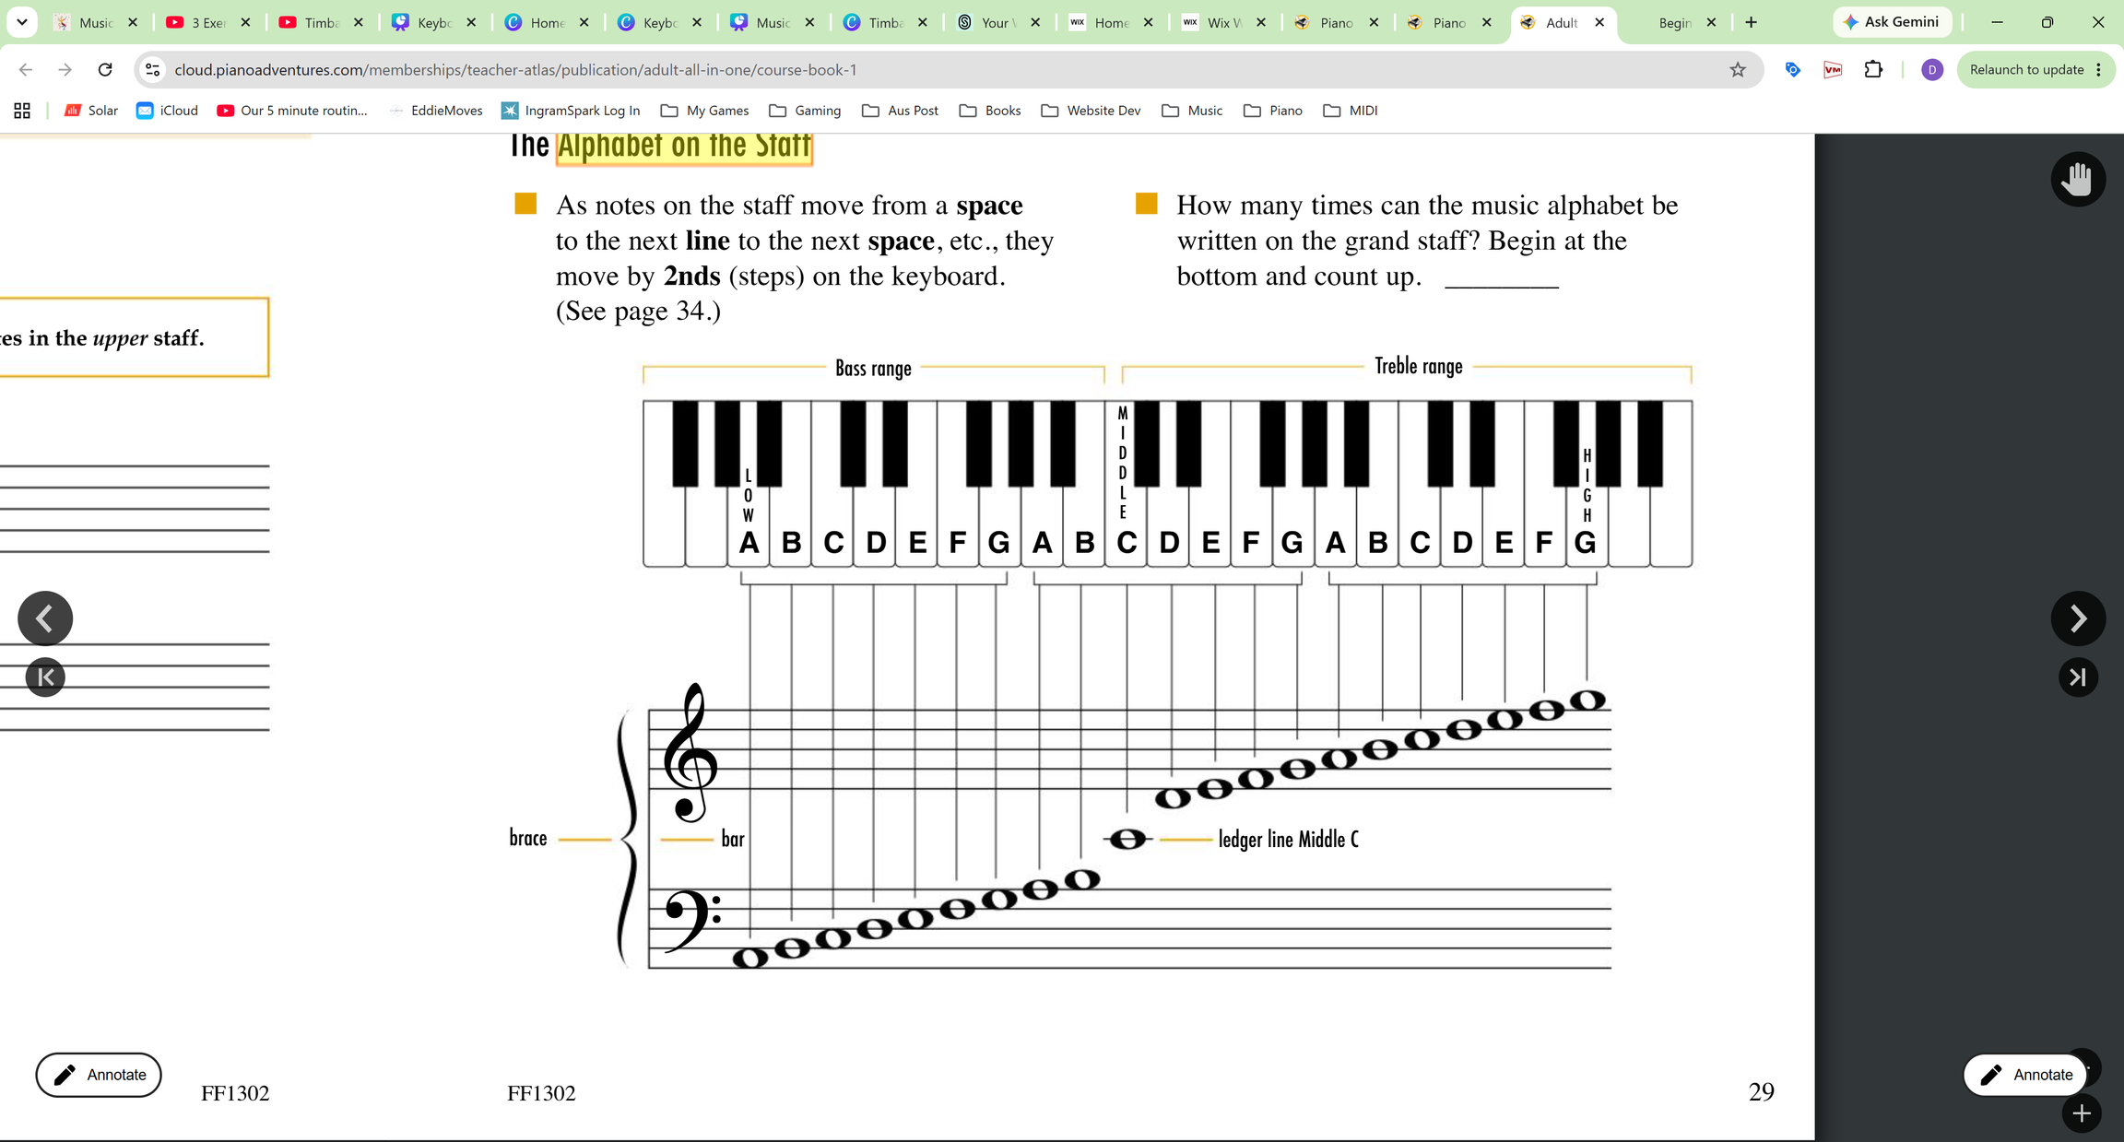
The Alphabet on the Staff
  With your L.H., use Finger 2 to play all of the Bass Staff notes (Low A to Middle C) ...
  ... After Middle C change to your R.H. Finger 2 and play the Treble Staff notes. Continue up to High G ...
  ... then play back down to Low A.

Slide 24
The Alphabet on the Staff (Ex. 2)
  Start at Low A on the Bass Staff and play the five notes in the spaces of the Bass Staff (skip the notes on the lines) ...
  ... After Middle C change to your R.H. Finger 2 and play the six notes in the spaces of the Treble Staff (up to and including High G) ...
  ... Play back down, but this time only play the notes on lines (skip notes in spaces).
NB: When playing only notes in spaces, or only notes on lines, you are playing intervals of a 3rd.

Slide 25
Exercise Workbook
Back to
Page 30

Slide 26
Practice at Home
Take Photo or download these slides from:
www.DaveBStevens.com/keyboard
Connecting the Mind to the Hands
  It takes time and practice to forge the memory pathways so that your fingers do what you want.
Some Things To Do This Week
  Study The Alphabet on the Staff diagram on page 29.
  Pick one thing we did this week to get better at. This could be:
    Practice the 4-Beat Alphabet on page 30.
    Practice the 3-Beat Alphabet on page 31.
    Practice Yankee Doodle on page 32.
  Go back and try and play Ode to Joy on page 24-25, all the way through.
  Familiarise yourself with the next 6-7 pages of the workbook, which we’ll study next lesson.
Each time you practice this week, play a quick warm-up before you start. Suggested warm-up:
  C Pentascale Warm-up on page 22.
  Warm-up with 3rds on page 23.
And if you play for more than 15 minutes, or if you experience discomfort, do the warm-up exercises from this video, before you play.

Slide 27
Lesson 5
Since the last lesson, did you ...
  Study The Alphabet on the Staff diagram on page 29?
  Pick one thing we did last week to get better at. This could be:
    Practice the 4-Beat Alphabet on page 30.
    Practice the 3-Beat Alphabet on page 31.
    Practice Yankee Doodle on page 32.
  Play Ode to Joy on page 24-25, all the way through?
Any questions that came
up during the week?

Slide 28
Exercise Workbook
Back to
Page 33

Slide 29
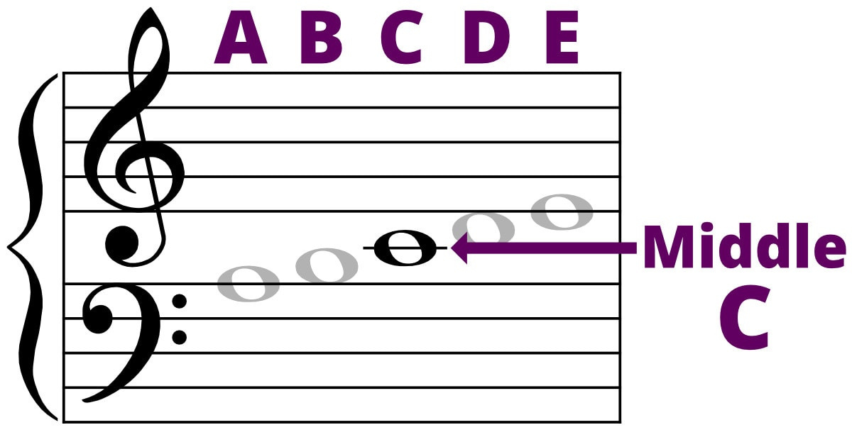
Middle C
On the Grand Staff, Middle C is shown on a short line below the treble stave and above the bass stave, which is called a leger line in Australia (and spelled ledger line in the American workbook) - as shown below:
(on a Leger line)
The acronym ACE is a great way to remember that:
  the top line of the Bass stave is A
  the leger line between the staves is C, and
  the bottom line of the Treble Stave is E.

Slide 30
Exercise Workbook
Back to
Page 34

Slide 31
Practice at Home
Handouts - Example Practice Session sheets
to make practice at home easier
Download a PDF of these from:
www.DaveBStevens.com/keyboard

Slide 32
Practice at Home
Take Photo or download these slides from:
www.DaveBStevens.com/keyboard
Some Things To Do This Week
  Memorise the location of the notes A-E on the staff (pages 34-36).
  Practice for 5 minutes, 3-4 times this week - Use your new Practice Sheet handouts.
  Familiarise yourself with the next 6-7 pages of the workbook, which we’ll study next lesson.
And if you play for more than 15 minutes, or if you experience discomfort, do the warm-up exercises from this video, before you play.

Slide 33
Lesson 6
Since the last lesson, did you ...
  Memorise the location of the notes A-E on the staff (pages 34-36).
  Practice for 5 minutes, 3-4 times this week - Use your new Practice Sheet handouts.
  Familiarise yourself with the next 6-7 pages of the workbook, which we’ll study next lesson.
Any questions that came
up during the week?

Slide 34
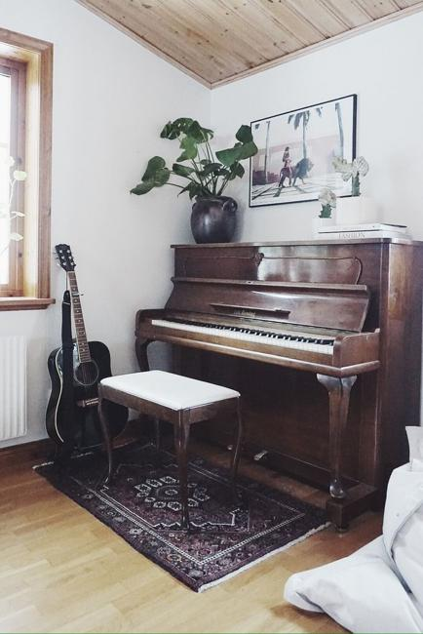
Developing A Practice Routine
The single most important step you can take in your learning journey!
  Habit Stacking - It is easier to link a new habit to an existing habit. For me, I have a sore back, so I stretch every day. I recently linked my piano practice to that, so after I stretch, I practice piano. It’s working well. Find something you do most days and link your practice routine to it.
  Environment - Set up your keyboard at home so it is always ready to play. That will make it easy for you to practice whenever the mood strikes you. Make it a comfortable and pleasant space. Make it a habit to set up your keyboard at home again after each lesson with me.
  Plan Your Practice - After each week’s lesson, spend a few minutes setting up that week’s practice using the practice planner I handed out last week (you can download it from the website). After 5 lessons, you now have lots of different things you can practice. For now, focus on things that you find enjoyable. All we’re doing at the moment is getting you used to the keyboard and establishing the practice habit, so keep it fun!

Slide 35
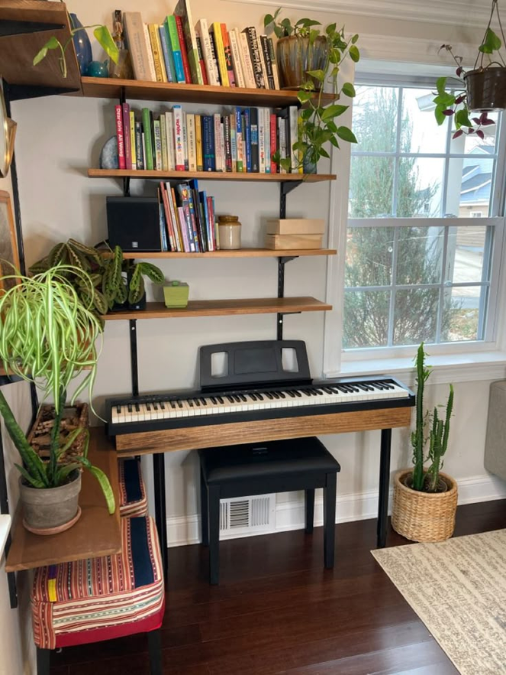
  Frequency of practice is more important than length of practice. Consistency is important to establish. Some people learn better by setting aside a specific time each day, but don’t aim to practice 7 days a week, because life gets in the way. Better to aim to practice 3-5 times per week for 5-15 minutes; then when you can’t practice for a day because something comes up, it won’t be a big deal. Studies show that as long as you return to the habit, occasional misses don’t impact progress.
  Quick Easy Wins - Make your practice plan achievable. Don’t set the goal of a piece that is significantly above your current ability. There’ll be time for those pieces later.
  Gamify Your Practice - Some people download a habit or streak tracking app on their phone to track progress.
  Define Your Goals in Terms of the Person You Want to Be - Not the Pieces You Can Play - “I will become someone who regularly enjoys playing music” rather than “I will learn this song by X date”. This is a long term hobby and you are building skills over time using a good practice process rather than setting specific milestones.
  Rewards - When you complete your weekly practice plan give yourself a reward. A sweet treat, a favourite meal, maybe a new piece of music equipment - yummy! :)
How long it takes to form an ongoing piano practice habit depends on how motivated you are to practice. If you’re very motivated, it might take as little as 18 days. Normally, it will take a couple of months to cement the habit and make it an ongoing and automatic part of your life.

Slide 36

For More Ideas on Establishing a Practice Routine Watch This Video

Slide 37
Exercise Workbook
Back to
Page 36

Slide 38
Octaves
Much of our music theory is in Italian because Italian musicians pioneered the rules of sheet music and standard performance notation during the Renaissance and Baroque periods. Because Italy dominated European music for centuries, their vocabulary became the international standard.
8va is the Abbreviation for Octave. Why? Because:
  An Octave contains 8 notes (E.g., C, D, E, F, G, A, B, C).
  Ottava means eighth (octave) in Italian.
  Italian words ending in -ava use -va as the abbreviation suffix.
  This is exactly how English uses -th for "eighth" (8th), giving us 8va.
15ma is the Abbreviation for Two Octaves. Why? Because:
  Two Octaves contain 15 notes (E.g., C, D, E, F, G, A, B, C, D, E, F, G, A, B, C).
  Quindicesima means fifteenth in Italian.
  Italian words ending in -esima use -ma as the abbreviation suffix.
  This is exactly how English uses -th for "fifteenth" (15th), giving us 15ma.

Slide 39
Exercise Workbook
Back to
Page 40

Slide 40
Octaves
A piano has 88 keys, with 7 complete octaves (from note C to C).
Your 61-key keyboard only has 5 complete octaves (C2 through C6):
C2
C3
C4
C5
C6
C7
Middle C
If you need to play notes in an Octave that is not on your keyboard you can press the Oct- or Oct+ buttons. Not all keyboards have dedicated buttons and we’ll look at your keyboard shortly. But first, let’s see what it does ...

Slide 41
Normal (you have not pressed the Oct+ or Oct- buttons):
C2
C3
C4
C5
C6
C7
Middle C
Press Oct- once (the Octaves across the entire keyboard go down by 1 - so all keys play a lower pitch):
C1
C2
C3
C4
C5
C6
Middle C
Press Oct+ twice (once to return to Normal and once to move Octave up - higher pitch):
C3
C4
C5
C6
C7
C8
Middle C

Slide 42
How to use Oct- and Oct+
If you get confused, turn your keyboard off and on again to remove any Octave shift.
Not all keyboards have dedicated buttons for Oct- and Oct+. Here’s what ChatGPT has to say about each of your keyboards (try it now and see if it works):
 | How to Shift Octave Up (Oct+) [So C2-C7 becomes C3-C8] | How to Shift Octave Down (Oct-) [So C2-C7 becomes C1-C6] | Additional Shortcut / Notes
Yamaha PSR-E383 | Press [FUNCTION] multiple times until the screen reads M.Octave. Use the numeric keypad [+/YES] button to raise it. | Press [FUNCTION] multiple times until the screen reads M.Octave. Use the numeric keypad [-/NO] button to lower it. | Pressing [+/YES] and [-/NO] together resets the octave shift to zero.
Yamaha PSR-E483 | Press the dedicated [OCTAVE] button on the panel, then turn the main dial/wheel clockwise to increase. | Press the dedicated [OCTAVE] button on the panel, then turn the main dial/wheel counter-clockwise to decrease. | The PSR-E483 introduces a dedicated hardware button, a distinct upgrade from the menus of the PSR-E383.
Casio CT-S100 | Press and hold the [FUNCTION] button. Pressing the G#3 key raises the pitch by 1 semitone. Press it 12 times (total) to raise the pitch by 1 Octave. Release [FUNCTION] button. | Press and hold the [FUNCTION] button. Pressing the F#3 key lowers the pitch by 1 semitone. Press it 12 times (total) to lower the pitch by 1 Octave. Release [FUNCTION] button. | On the ultra-minimalist Casio Casiotone CT-S100, there is no screen and no parameter menu layout. It does not have a native "Octave Shift" menu feature like the higher-tier models.
Casio CT-S1-76 | Hold down the [FUNCTION] button, then press the physical piano key D#3. | Hold down the [FUNCTION] button, then press the physical piano key C#3. | A short notification chime will play to confirm the shift has registered.
Nux NEK-100 | Press the [SETTINGS] button, select Octave Shift, and use the arrow/value keys to increase to +1. | Press the [SETTINGS] button, select Octave Shift, and use the arrow/value keys to decrease to -1. | Settings can be saved to one of the 5 User Presets so you don't have to menu-dive during live playback.
Take a photo of this page or download the slides

Slide 43
Exercise Workbook
Back to
Page 40

Slide 44
Practice at Home
Take Photo or download these slides from:
www.DaveBStevens.com/keyboard
Some Things To Do This Week
  Practice changing Oct- and Oct+ on your keyboard. Make a note of how to do it so that you can reference it quickly in class (this won’t be needed often).
  Add the new things you’ve learned today to the first page of your practice planner.
  Plan this coming weeks practice. Focus on things you find fun and aim to practice 3-5 times this week for 5-15 minutes. Link your practice to something you already do most days.
  Set up your keyboard at home as soon as you get there. Make it an inviting space.
And if you play for more than 15 minutes, or if you experience discomfort, do the warm-up exercises from this video, before you play.

Slide 45
Lesson 7
Since the last lesson, did you ...
  Practice changing Oct- and Oct+ on your keyboard and note how to do it?
  Did you link your practice to something you already do most days?
  Plan last week’s practice and then follow your plan, practising 3-5 times for 5-15 minutes?
  Make your practice room at home an inviting space and leave your keyboard set up?
Any questions that came
up during the week?

Slide 46
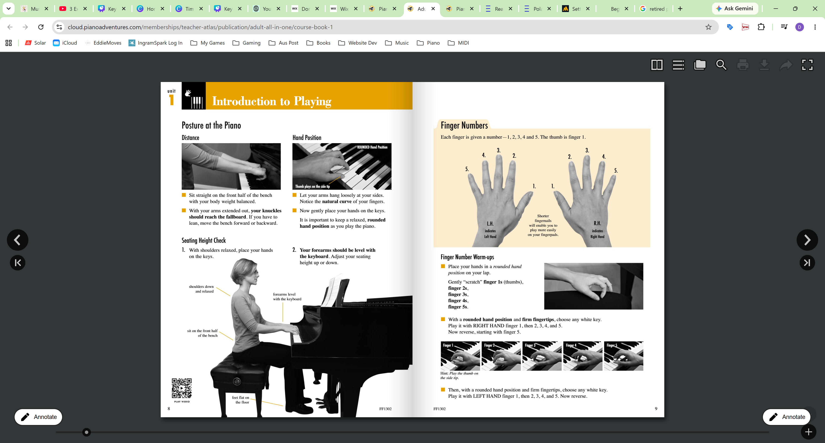

Lets Double Check Your Home Setup
Piano
Keyboard
(Diagram from page 8)
  Height adjustable bench seat. and/or
  Height adjustable keyboard stand
(For tips see www.DaveBStevens.com/keyboard)

Slide 47
Exercise Workbook
Back to
Page 42

Slide 48
Why Learn Keyboard?
To play songs of course!
  In the past 6 weeks we’ve learned to play quite a few tunes.
  And they are all great learning tools.
  Now it’s time to choose your own song to learn. One that you love and want to play.
  There are two sources for this first song:
  The Internet, or
  There are a series of companion books to this course that include appropriate levels of popular, classical and other songs.

Slide 49
The Internet - Setting Realistic Goals for Songs You’d Like to Learn
Music on the Internet
Sheet music on the Internet usually comes in two types:
  Melody is the catchy, single line of notes that you sing along to.
  Harmony is the supporting notes played underneath to give the tune its mood and depth.
  For piano, it is common for the melody to be played in the right hand and the harmony to be played with the left. But sometimes the music will only show Melody or only show Harmony.
Music is written for many different skill levels. The most common of these are:
  Beginner
  Intermediate
  Advanced
Pros | Cons
Amazing choice | Finding the song you want written at an early beginner level can be tricky
There might be a YouTube tutorial that could include the music | A lot of music is not broken down by skill level and might not be for piano
It might be free | “Beginner” is a broad term, so even music labelled Beginner might be beyond your current skills.
The easiest way to learn a song is to choose one that is at, or slightly below, your current skill level. You are currently: Early Beginner - Piano

Slide 50




Companion Music Books to this Course
I‘ve added links to these companion books to the website:
www.DaveBStevens.com/keyboard

Slide 51
Example: The Popular Music Book
This book has sheet music for 33 songs. Here are the 13 songs that are at, or only slightly above, your current level (you should be able to learn any of these):
  Let It Be - Beatles
  Twist and Shout - Beatles
  My Heart Will Go On (Titanic)
  Oh, What a Beautiful Morning
  Downton Abbey (Theme)
  Do-Re-Mi (Sound of Music)
  Edelweiss (Sound of Music)
  Climb Every Mountain (Sound of Music)
  Chim Chim Cher-ee (Mary Poppins)
  Let’s Go Fly a Kite (Mary Poppins)
  There’s No Business Like Show Business
  If I Were a Rich Man (Fiddler on the Roof)
  Tomorrow (Annie)

Slide 52
Practice at Home
Take Photo or download these slides from:
www.DaveBStevens.com/keyboard
Some Things To Do This Week
  Find the beginner sheet music for a song that you would like to learn (no need to start learning it yet, just find the sheet music). Bring it to the next lesson.
  Update your practice plan with this week’s learnings and follow your plan.
And if you play for more than 15 minutes, or if you experience discomfort, do the warm-up exercises from this video, before you play.

Slide 53
Lesson 8
Since the last lesson, did you ...
  Find the beginner sheet music for a song that you would like to learn and bring it with you today? (if you didn’t, don’t worry; I have a song that you can learn)
Any questions that came
up during the week?

Slide 54
Exercise Workbook
Back to
Page 48

Slide 55
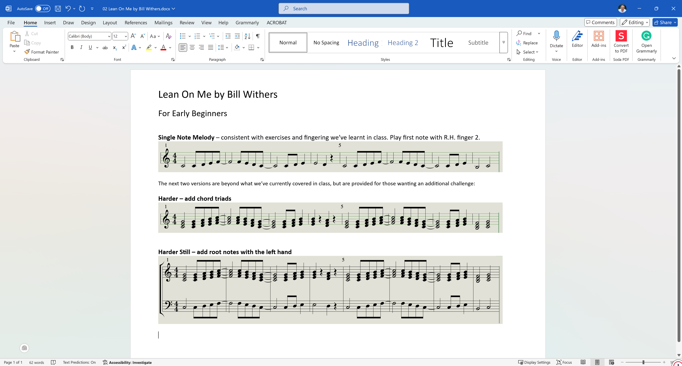
An Easy Song to Impress Your Friends
What makes this an easy song?
  This 8-bar sequence repeats throughout the entire song.
  Performance speed is only 75 bpm.
  Bars 1-3 are the same as 5-7.

Slide 57
Let’s Work on the Song You’ve Chosen
  Start by looking for sequences: A, A1, B, etc (repeating patterns).
  If the song has a treble and a bass clef, work on the treble clef first.
  Learn two bars at a time. Work out the best fingering for you and write it on the score.
  Start at a slow tempo.
  Focus on the timing of each note (half notes, quarter notes, eighth notes).
  Once you’re happy with the first two bars, repeat the process for the next two bars.
  Then put those four bars together.
  Continue learning two bars at a time and then add them to your practice.
  Gradually get faster until you're playing at the correct speed.
  If your song has a treble and bass clef, if the bass clef is simple then:
    Once you know the treble clef, work on the bass clef using the same process as above.
    Don’t try hands together until you’ve slept. Sleep consolidates your new short-term memories of playing hands separately before you practice hands together.
If your song is longer than 16 bars, then break it into sections such as Introduction, Verse, Chorus, and learn each of these using the process above.

Slide 58
Practice at Home
Take Photo or download these slides from:
www.DaveBStevens.com/keyboard
Some Things To Do This Week
  Update your practice plan with this week’s learnings and follow your plan.
  Add the song you’ve chosen to your practice plan so you improve your performance of it every time you practice. We’ll check progress at the next lesson. (If you haven’t chosen a song to learn yet, do it this week. Or, use Lean on Me by Bill Withers.)
  Read to the end of page 53.
And if you play for more than 15 minutes, or if you experience discomfort, do the warm-up exercises from this video, before you play.

Slide 59
Lesson 9
Since the last lesson, did you ...
  Add the song you’ve chosen to your practice plan so you improve your performance of it every time you practice?
Any questions that came
up during the week?

Slide 60
Exercise Workbook
Back to
Page 50

Slide 61
Your Song
  Learn it over the break and when we come back you will have the opportunity to play it for the class.
  Performing for others can be an enjoyable part of learning the piano.
  You won’t have to come out the front, when the time comes simply unplug your headphones so we can all hear you play. This gives you a real incentive to learn your song.
  If, after learning your song, you’d rather not perform for the class, you won’t have to. But I encourage you to give it a go, so that you’re squeezing every drop of fun and learning from this class that you can! After all, we’re all in this together, and it’s easier to experience your first performance here and make mistakes in front of people who understand, versus doing it out in the world :)

Slide 62
Performing versus Practising
Practising
  When practising the goal is to learn how to play the song and lock in those memories.
  If you make a mistake, try again.
  If you have trouble with a particular section then practice it over and over slowly until you get it right.
Performing
  When performing, you play the song through from start to end.
  You should ignore mistakes and just carry on. Don’t react. The audience won’t even notice small mistakes. But if you react or stop, then they will notice that!
  Try not to let any errors annoy you. It can be difficult. But if you’re thinking about your last mistake, you’re not thinking about the next part of the song you’re still playing.
  The more you perform, the easier it gets. Think of it as performance “growing pains”.
  Before a performance, I tell myself this is just a different type of practice - this works for me to reduce the stomach butterflies.

Slide 63
Bulletproof Your
Performance
The best way to build performance confidence is to know how to play your song really, really well.
Don’t just practice until you know your song. Practice until you know it so well you can play it without thinking!

Slide 64
End of Term - Listening Quiz
  Without moving too much, form teams of 3 or 4 people.
  Each team gets a pen and paper. Agree on one person to write down the answer.
  Each Round - I will play one of 5 notes that you know well: Middle C, D, E, F or G.
  You’ll have 15 seconds to whisper/discuss quietly and write down the note name that I played. No touching your keyboards!
  When I ask, hold up your answers. Correct answers get one point.

Slide 65
Practice at Home
Take Photo or download these slides from:
www.DaveBStevens.com/keyboard
Some Things To Do Over the Break
  Continue practising as often as you can.
  Three or four times per week for 10-15 minutes is a good goal.
  Learn your song so well that you can’t make a mistake.
  Remember that enjoying the learning process is the most important thing! (but it is normal to hit occasional barriers that take time and practice to get over)
And if you play for more than 15 minutes, or if you experience discomfort, do the warm-up exercises from this video, before you play.

Slide 66
Lesson 10
Since the last lesson, did you ...
  Practice regularly?
  Learn your song?
Any questions that came
up since the last class?

Slide 67
Recognising Intervals By Listening
At the end of last class we played a listening quiz.
It can be tricky to listen to two notes and recognise the interval between them without a frame of reference. So here’s the reference:
Interval | For Example | Reference Song | Start of the Reference Song
Unison (no interval) | C to C | - | -
2nd | C to D | Happy Birthday | Ha-ppy Birth ... C C D
3rd | C to E | Oh When the Saints | Oh When ... C E
4th | C to F | Here Comes the Bride | Here Comes ... C F
5th | C to G | Twinkle Twinkle | Twin-kle Twin ... C C G

Slide 68
Spend 5 Minutes
Practising Your Song
Then we’ll go around the room and everyone will have a chance to perform for the class
Don’t put extra pressure on yourself. Pretend you’re just practising at home.

Slide 69
Time to Perform Your Song
Remember ...
  When performing, you play the song through from start to end.
  If you make a mistake, just ignore it and carry on. Only you have the music sheet in front of you and know what notes should be played.
Performance Anxiety
  This is a safe space. Everyone is learning and no-one will judge you harshly.
  “Butterflies” in the stomach are normal. They are a response to the body releasing adrenaline into the bloodstream.
  A little adrenaline is a good thing. It helps you perform at your best.
  Before a performance, I tell myself this is just a different type of practice - this works for me to reduce the stomach butterflies.
The more you perform, the easier it gets. Think of it as performance “growing pains”.

Slide 70
Exercise Workbook
Back to
Page 54

Slide 71
Practice at Home
Do You Still Have a Practice Plan?
Remember the Handouts from Term 1?
Download and use them to make practice at home easier
Download a PDF of these from:
www.DaveBStevens.com/keyboard

Slide 72
Practice at Home
Take Photo or download these slides from:
www.DaveBStevens.com/keyboard
Some Things To Do This Week
  Revisit your Practice Plan.
  Practising 3-4 times per week for 10-15 minutes is a good goal.
  Read the next 6-7 pages of the textbook.
And if you play for more than 15 minutes, or if you experience discomfort, do the warm-up exercises from this video, before you play.

Slide 73
Lesson 11
Since the last lesson, did you ...
  Revisit your Practice Plan.
  Practising 3-4 times per week for 10-15 minutes is a good goal.
Any questions that came
up since the last class?

Slide 74
Spend 5 Minutes
Practising Your Song
Then
Maria, Aily, Gil, Don, Susan and Pam will have a chance to perform for the class
Don’t put extra pressure on yourself. Pretend you’re just practising at home.

Slide 75
Time to Perform Your Song
Remember ...
  When performing, you play the song through from start to end.
  If you make a mistake, just ignore it and carry on. Only you have the music sheet in front of you and know what notes should be played.
Performance Anxiety
  This is a safe space. Everyone is learning and no-one will judge you harshly.
  “Butterflies” in the stomach are normal. They are a response to the body releasing adrenaline into the bloodstream.
  A little adrenaline is a good thing. It helps you perform at your best.
  Before a performance, I tell myself this is just a different type of practice - this works for me to reduce the stomach butterflies.
The more you perform, the easier it gets. Think of it as performance “growing pains”.

Slide 76
Exercise Workbook
Back to
Page 58

Slide 77
Practice at Home
Take Photo or download these slides from:
www.DaveBStevens.com/keyboard
Some Things To Do This Week
  Revisit your Practice Plan.
  Practising 3-4 times per week for 10-15 minutes is a good goal.
  Read the next 6-7 pages of the textbook.
And if you play for more than 15 minutes, or if you experience discomfort, do the warm-up exercises from this video, before you play.

Slide 78
Lesson 12
Since the last lesson, did you ...
  Revisit your Practice Plan.
  Practising 3-4 times per week for 10-15 minutes is a good goal.
Any questions that came
up since the last class?

Slide 79

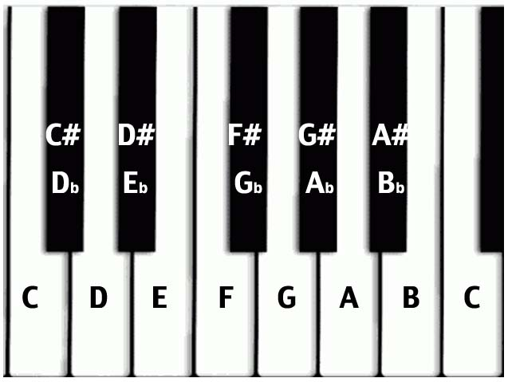
C Major Scale
White keys only. There are no black keys in the C Major scale.

Slide 80
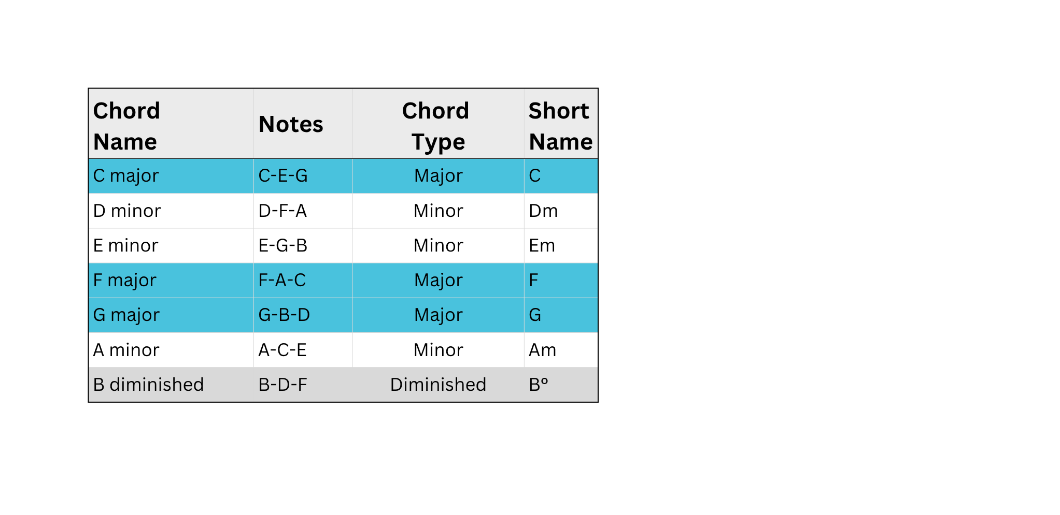
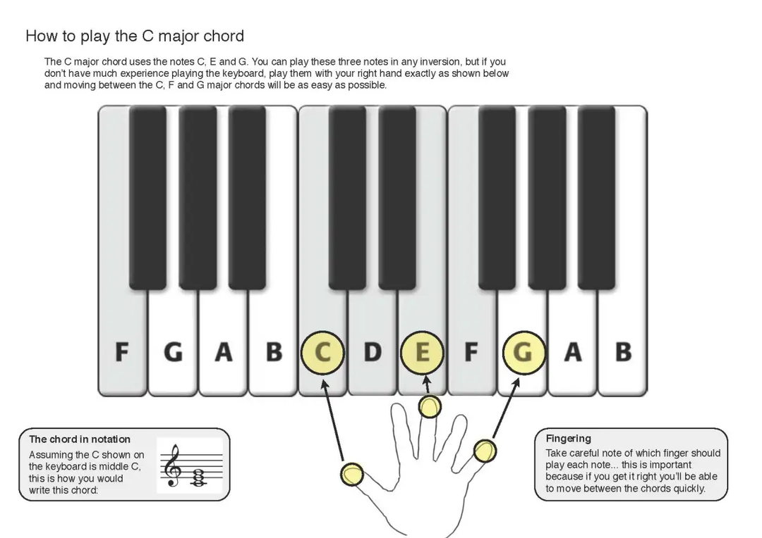
Chord Triads in the C Major Scale
In every major scale, you can build a triad (a 3‑note chord) starting on each note of the scale. Each triad uses only the notes from the scale. In C major, the notes are: C – D – E – F – G – A – B
How to Play
Play C major as shown above.
Now, without changing the shape of your hand, move up one note and play D minor. Continue moving up the keyboard, one note at a time, and play all 7 chords.
You can build a triad on every note of the C major scale. All of these chords use only white notes because C major has no sharps or flats.
These 7 chords are the building blocks of thousands of songs.

Slide 81
Let It Be - Accompaniment
Here are the first 16 bars of the Beatles’ song Let It Be. The chords have been simplified so there is nothing that you haven’t already learned. They are all played with the right hand on a piano.
Intro
1
Verse 1
= 72
Chorus
When I find myself in tiimes of trouble And in my hour of darkness she is
Mother Mary comes to me Speaking words of wisdom
Let it be
standing right in front of me Let it be Leit it be Let it be Let it be Whisper words of wisdom Let it be
Speaking words of wisdom
Let it be
This might look a little scary at first glance, but we’ll break it down on the next page.
A Melody is a sequence of single notes played one after another that forms a musical line. It is usually the part of the music you can hum or sing. In Let It Be, the melody is sung by Paul McCartney and the lyrics appear above.
Harmony is what happens when two or more notes sound at the same time. It creates the sense of depth or richness beneath a melody using chord progressions (a series of chords). The Harmony is played on the piano using the chords above.

Slide 82
Step 1 - Identify Repetition
Bars 1-4 are the same as bars 5-8, which are the same as bars 9-12. So by learning how to play bars 1-4, we also learn how to play the first 12 bars. So let’s focus on the first repetition (bars 1-4).
Intro
1
Verse 1
= 72
Chorus
When I find myself in tiimes of trouble And in my hour of darkness she is
Mother Mary comes to me Speaking words of wisdom
Let it be
standing right in front of me Let it be Leit it be Let it be Let it be Whisper words of wisdom Let it be
Speaking words of wisdom
Let it be
Step 2 - Identify Chords
Note the chords being used in the repeated section (bars 1-4).
C G Am F C G F Em Dm C

Slide 83
C G Am F C G F Em Dm C
Bars 1-4 are simply repeated here for reference
Step 3 - Break it Down and Practice Slowly
If you are experienced at playing these chords, take the first 2 bars and practice those on repeat. Once you can move confidently between those chords, move to the next 2 bars.
However, if you are a piano beginner:
  Start by locating the first chord (C Major) on the keyboard. NB: It is not middle C, it is the next C to the right (one octave up).
  Using your right hand, place your thumb on C, middle finger on E and little finger on G.
  Play these three notes simultaneously and continue playing for 2 beats, then play it again and hold for 2 more beats. Become comfortable doing this before moving on.
  The next chord is G major and it is below the C on the stave, so you move your hand to the left until you find G. Maintain the same hand shape that you used for C and when your thumb is over G, your middle finger should be over B and your little finger should be over D. Play this chord for 2 beats, and keep playing it until you’re comfortable with it.
  Now comes the tricky part. We need to learn to move between the chords C major and G major. Start slowly. Play C for 2 beats, then move to G and play it for 2 beats. Then move back to C and repeat until you are comfortable.
  Now we’ll practice bar 2, which has A minor (Am) and F major (F). Am is A-C-E and F is F-A-C. So, to find Am when you are on G, you move your entire hand one note to the right. And to find F when you are on Am, move your entire hand two notes to the left. Practice bar 2 until you are comfortable.
  Now try playing bars 1 and 2 together: Start on C, move left to G, move right to Am, move left to F. Repeat.
  Keep practicing as slowly and as much as you need to in order to create muscle memory for moving between chords.
Congratulations - you’ve played your first chord progression!

Slide 84
Exercise Workbook
Back to
Page 61

Slide 85
Practice at Home
Take Photo or download these slides from:
www.DaveBStevens.com/keyboard
Some Things To Do This Week
  Practice moving between the chords of Let It Be.
  Continue with your Practice Plan.
  Practising 3-4 times per week for 10-15 minutes is a good goal.
  Read the next 6-7 pages of the textbook.
And if you play for more than 15 minutes, or if you experience discomfort, do the warm-up exercises from this video, before you play.

Slide 86
Lesson 13
Since the last lesson, did you ...
  Practice moving between the chords of Let It Be?
  Practice 3-4 times for 10-15 minutes?
Any questions that came
up since the last class?

Slide 87
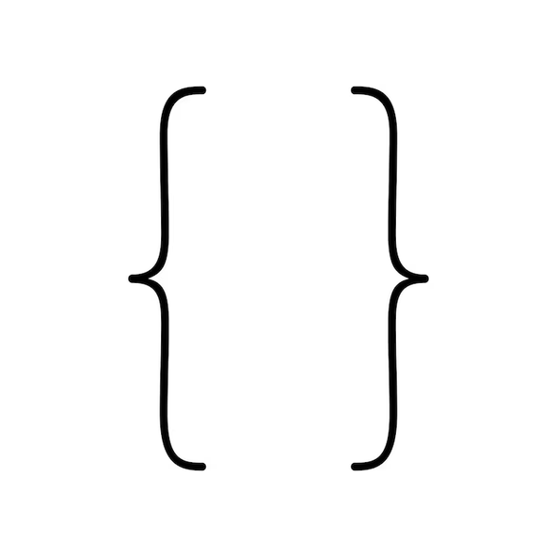
C G Am F C G F Em Dm C
Bars 1-4 of Let It Be
for reference
8va under the staff means to play the notes one octave lower than written
8va
1
Play bars 1-2 on repeat (each chord lasts 2 beats). Hold down the sustain pedal.
Too hard?
Too easy?
2
Give yourself more time by making each chord last 4 beats.
(If needed just play bar 1, then just play bar 2, before playing bars 1 and 2 together).
2
Play each chord in the first 3 bars as quarter notes instead of half notes (1 beat per chord instead of 2 beats per chord).
Too easy?
3
Set your metronome to 72 bpm and play each quarter note on the correct beat.
4
Play the root note of the chord in your left hand.
Too easy?

Slide 88
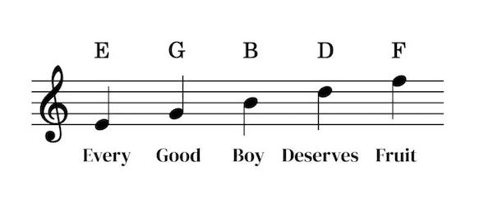
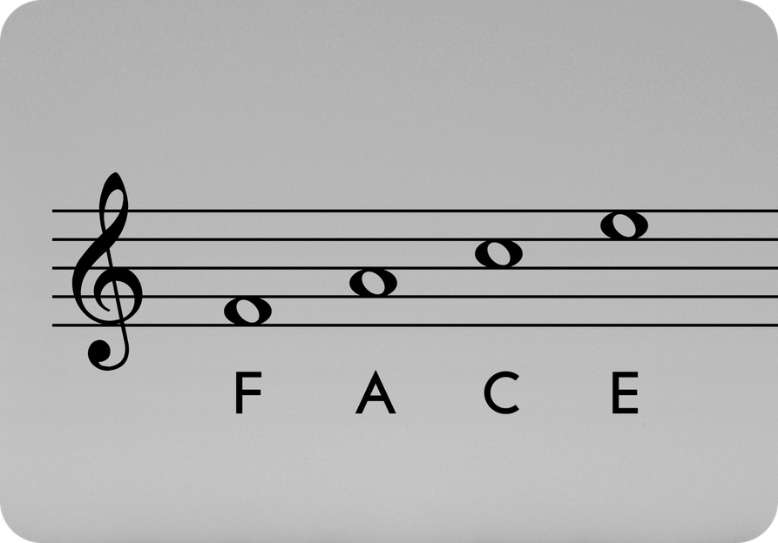
Recognising the name of each note on the treble stave is a fundamental skill that we need to learn.
To make this easier, here is an acronym for the notes on each line of the Treble stave:
The notes in each space of the Treble stave, make the word “FACE”:

Slide 89
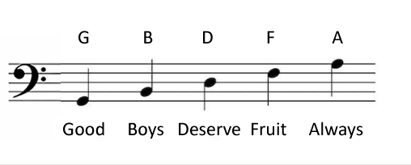
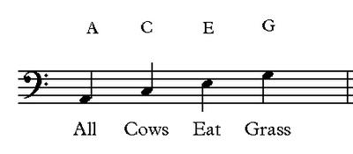
Recognising the name of each note on the bass stave is a fundamental skill that we need to learn.
To make this easier, here are acronyms for the notes on each line of the Bass stave:
or Good Birds Don’t Fly Away
And here is an acronym for the notes in each space of the Bass stave:

Slide 90
Exercise Workbook
Back to
Page 64

Slide 91
Practice at Home
Take Photo or download these slides from:
www.DaveBStevens.com/keyboard
Some Things To Do This Week
  Memorise the acronyms for the treble stave: “Every Good Boy Deserves Fruit” and “FACE”.
  Keep practising the chords of Let It Be until you can play them at 72 bpm.
  Practice 3-4 times per week for 10-15 minutes is a good goal.
  Read the next 6-7 pages of the textbook.
And if you play for more than 15 minutes, or if you experience discomfort, do the warm-up exercises from this video, before you play.

Slide 92
Lesson 14
Since the last lesson, did you ...
  Memorise the acronyms for the treble stave: “Every Good Boy Deserves Fruit” and “FACE”.
  Keep practising the chords of Let It Be until you can play them at 72 bpm.
  Practice 3-4 times per week?
Any questions that came
up since the last class?

Slide 93
Recognising the name of each note on the bass stave is a fundamental skill that we need to learn.
To make this easier, here are acronyms for the notes on each line of the Bass stave:
or Good Birds Don’t Fly Away
And here is an acronym for the notes in each space of the Bass stave:

Slide 94
Let It Be - Section B - The Last 4 Bars
Now you know how to play the first 4 bars:
A
A
Intro
1
Verse 1
= 72
8va
Chorus
When I find myself in tiimes of trouble And in my hour of darkness she is
Mother Mary comes to me Speaking words of wisdom
Let it be
A
B
standing right in front of me Let it be Leit it be Let it be Let it be Whisper words of wisdom Let it be
Speaking words of wisdom
Let it be
Let’s identify the chords being used in bars 13-16 and practice playing it:
Section B
Am Am G G F F C C C C G G
8va
F Em Dm C

Slide 95
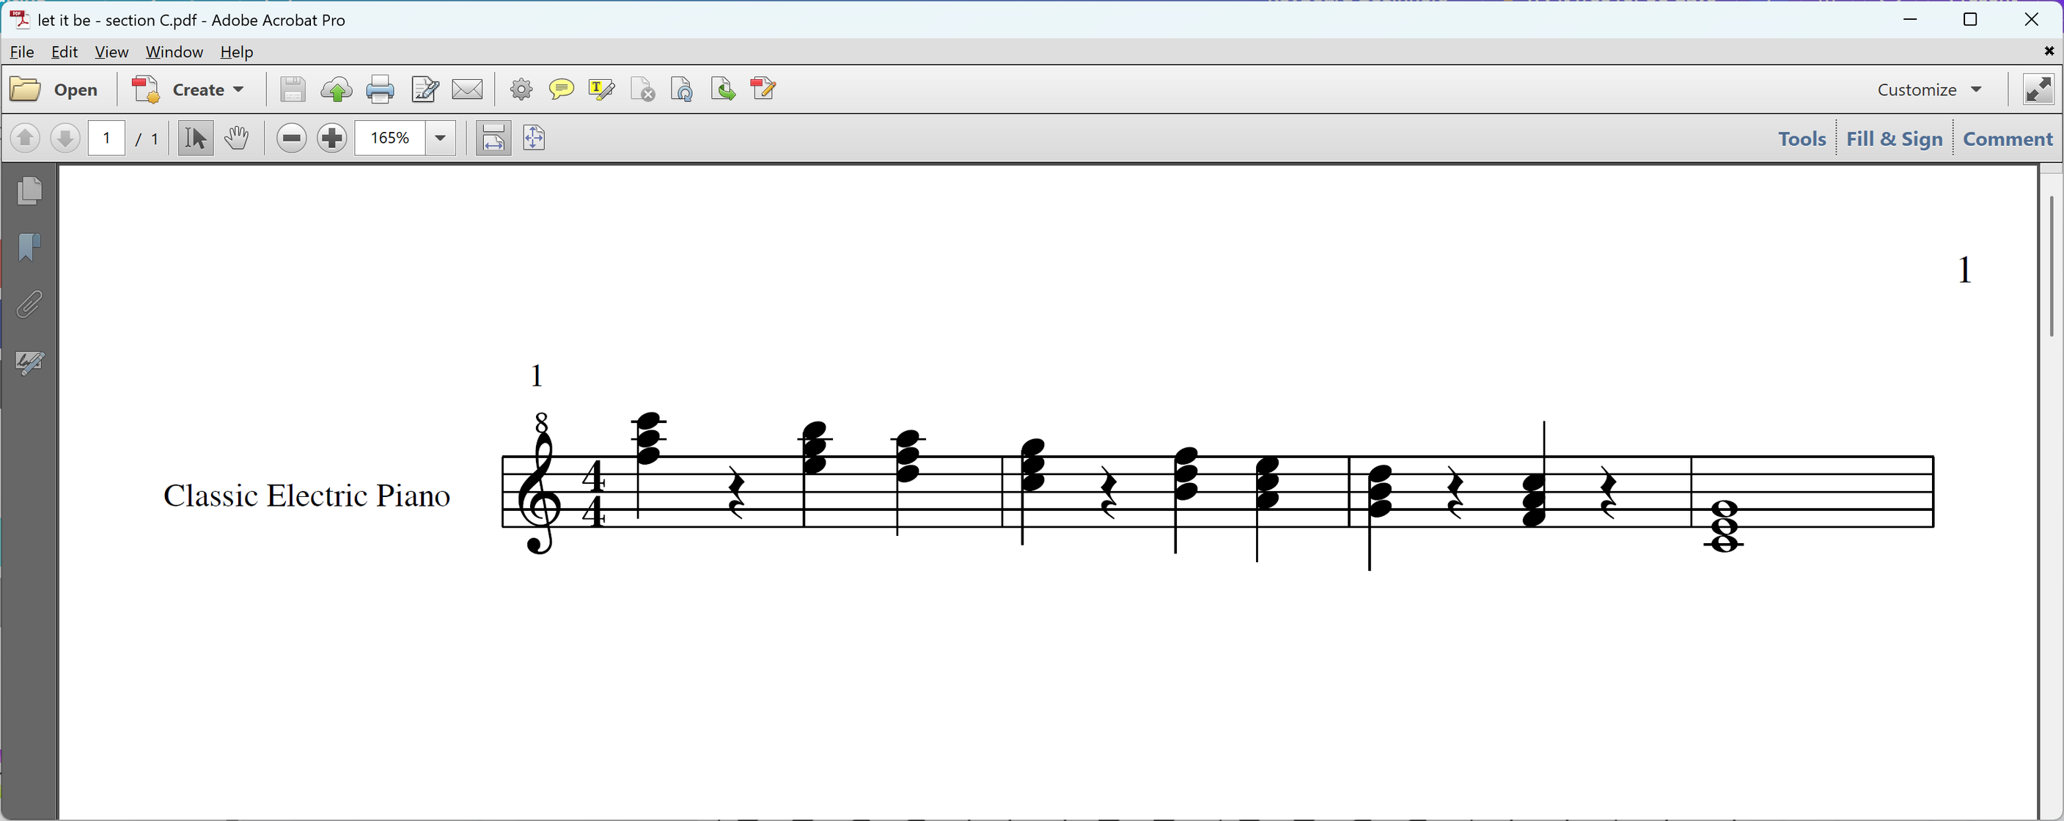
Let It Be - Section C - The Bridge
  Section A is the Intro and Verses
  Section B is the Chorus
  Section C is the Bridge (a contrasting section of a song that connects two other sections)
Section C
F Em Dm C B° Am G F C

Slide 96
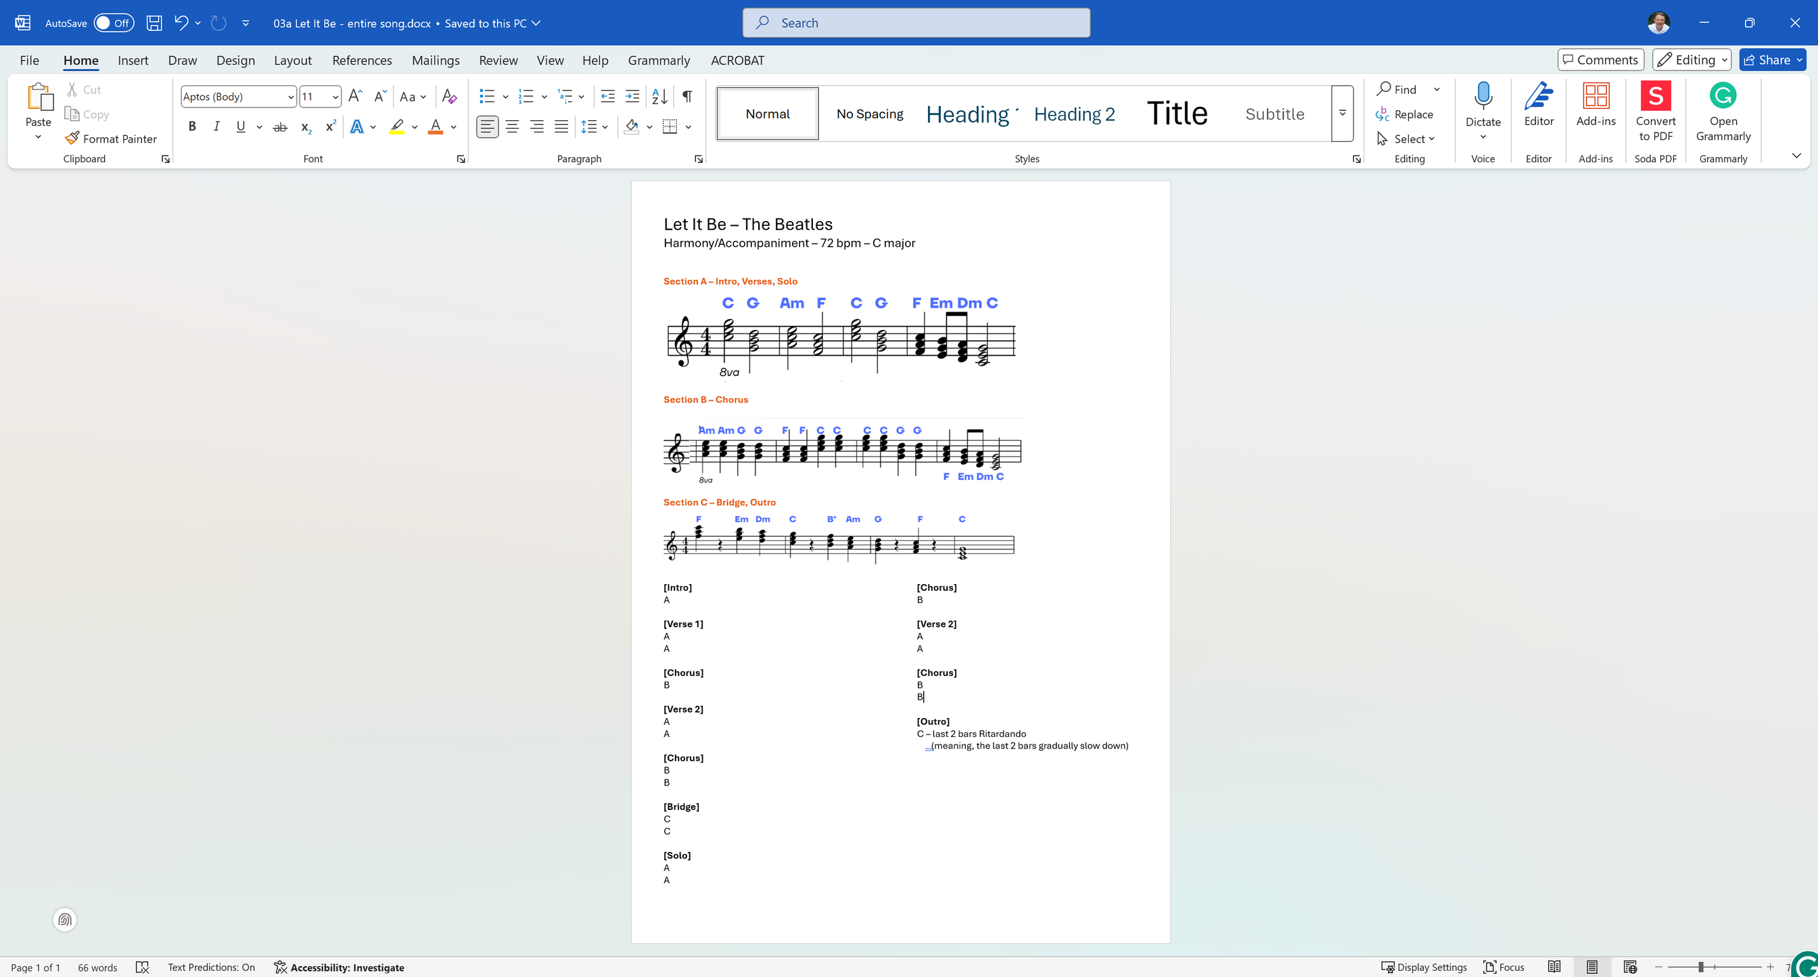
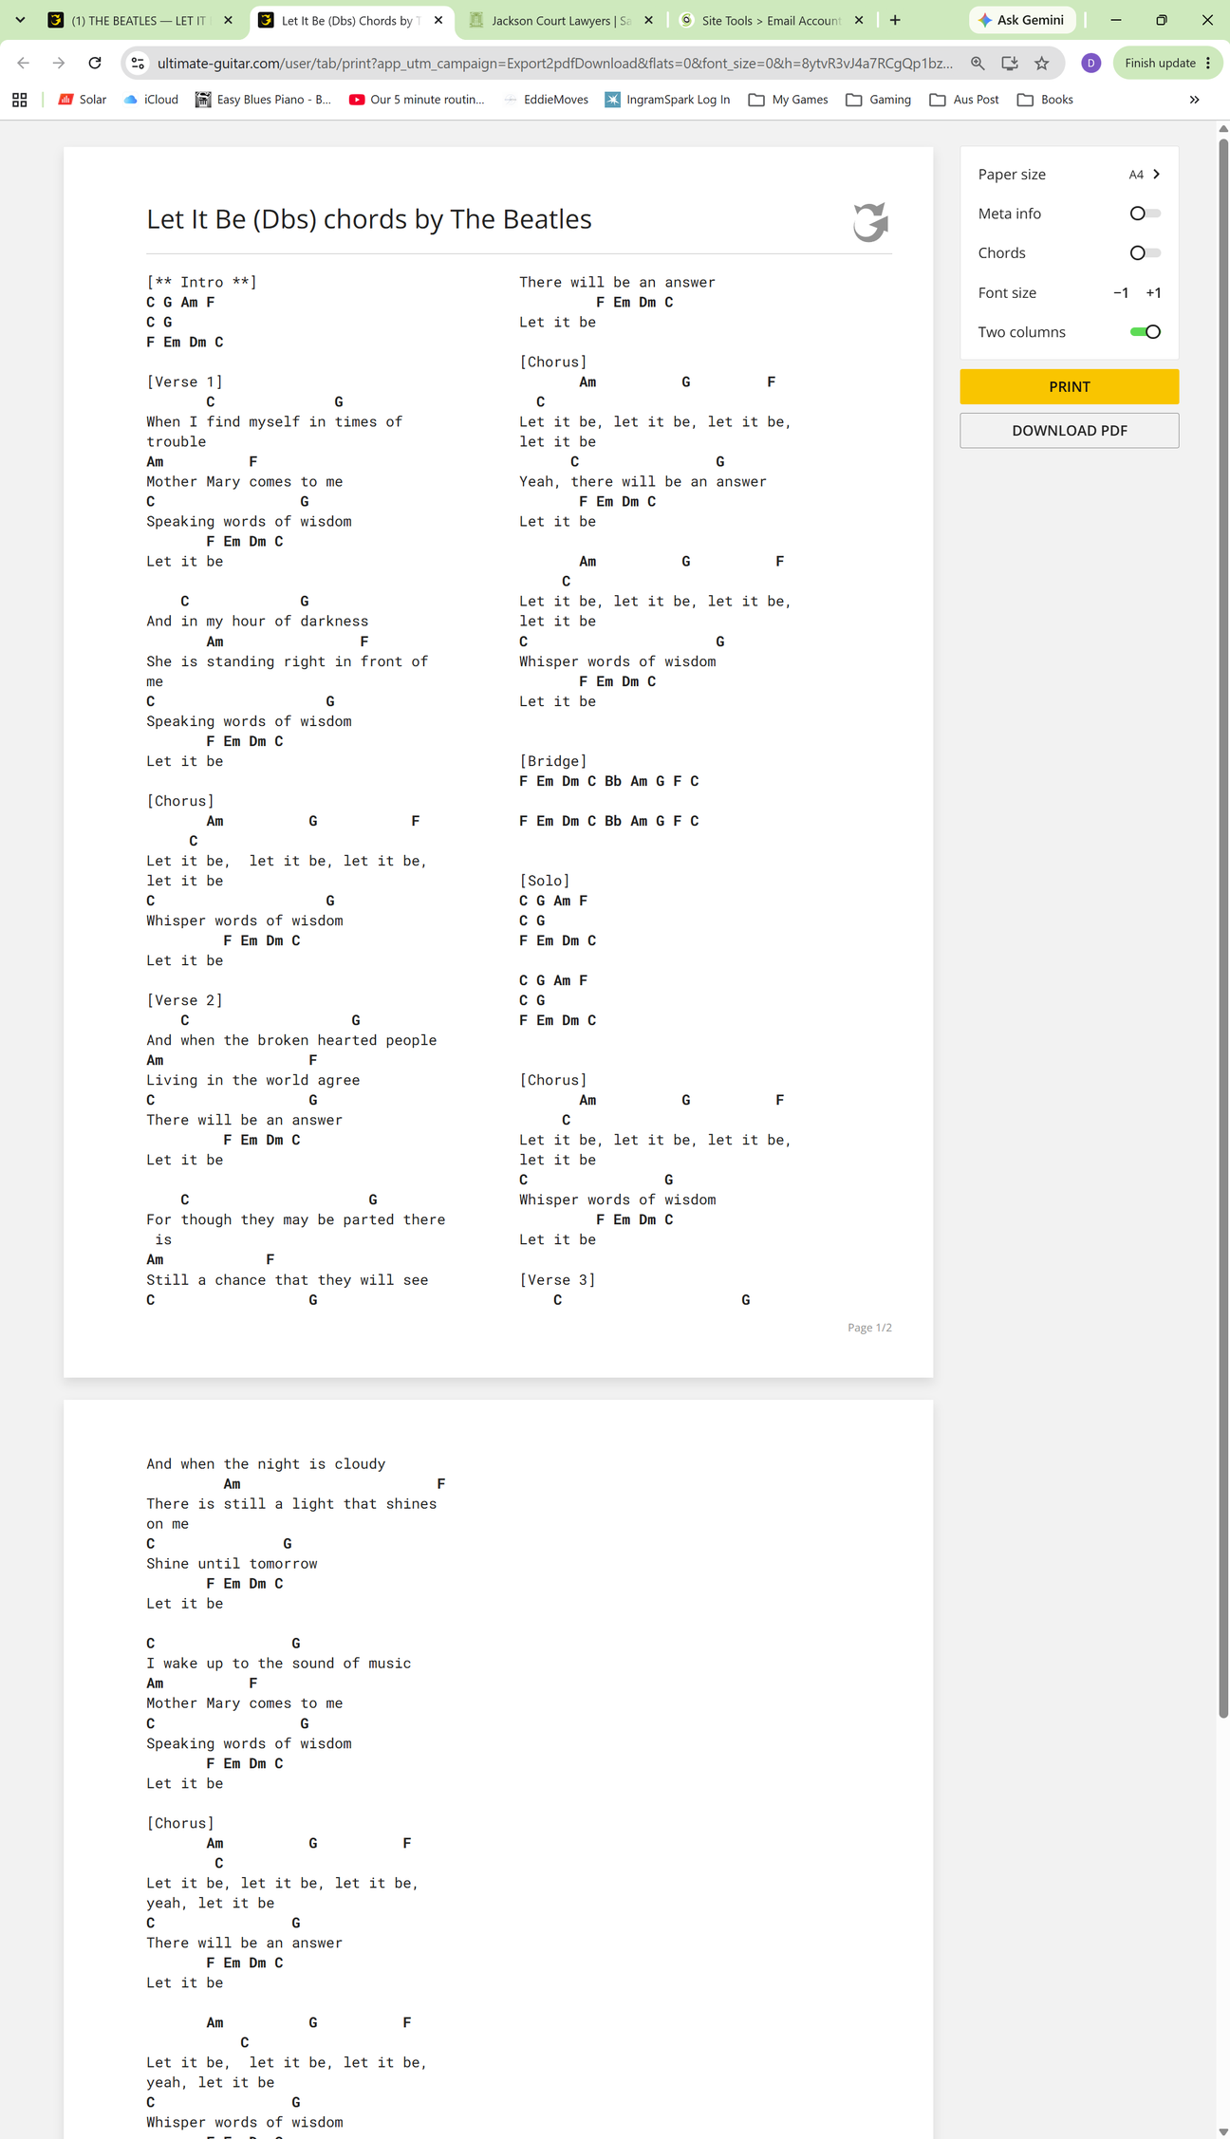
Let It Be - Putting It All Together
Sheet Music By Sections
Chord Chart
or

Slide 97
Exercise Workbook
Back to
Page 70

Slide 98
Practice at Home
Take Photo or download these slides from:
www.DaveBStevens.com/keyboard
Some Things To Do This Week
  Memorise the acronyms for the bass stave: “Good Birds Don’t Fly Away” and “All Cows Eat Grass”.
  Keep practising the chords of Let It Be until you can play them at 72 bpm. Next week we will play the entire song together.
  Practice 3-4 times per week for 10-15 minutes is a good goal.
  Read the next 6-7 pages of the textbook.
And if you play for more than 15 minutes, or if you experience discomfort, do the warm-up exercises from this video, before you play.

Slide 99
Lesson 15
Since the last lesson, did you ...
  Memorise the acronyms for the bass stave: “Good Birds Don’t Fly Away” and “All Cows Eat Grass”?
  Practiced Let It Be (the entire song)?
Any questions that came
up since the last class?

Slide 100
2027 Keyboard Class
In 2027, we will continue this class from wherever we finish up at the end of 2026.
The time and room will change:
  Monday 9.00 am - 10.20 am
  Room 13 - Which is larger than Room 15, and there is enough room for everyone to be able to use their own keyboard.
U3A rules mean enrolments are first come, first served. There’s nothing I can do to give preference to you over anyone else who wants to enrol. There are currently 8 people on the waiting list.
So put it in your diary and enrol ASAP to avoid disappointment:
Music Keyboard Level 2
General enrolments open Thursday 26 November 2026

Slide 101
Let It Be - Putting It All Together
Sheet Music By Sections
Chord Chart
or

Slide 102
Exercise Workbook
Back to
Page 76?

Slide 103
Practice at Home
Take Photo or download these slides from:
www.DaveBStevens.com/keyboard
Some Things To Do This Week
  Keep practising songs that you don’t want to forget. These might include:
    Let It Be
    Lean on Me
    The song you chose to learn and perform for Lesson 10.
    Others?
  Practice 3-4 times per week for 10-15 minutes is a good goal.
  Read the next 6-7 pages of the textbook.
And if you play for more than 15 minutes, or if you experience discomfort, do the warm-up exercises from this video, before you play.

