Slide 1



Music Theory
Grade 1
Understanding the Basics using
Real Music Examples
Prerequisites:
None
Exercise Workbook:
Master Your Theory
Grade One
by Dulcie Holland
(Available on Amazon or
from music stores)
Download Slides From:
www.davebstevens.com/music-theory

Slide 2
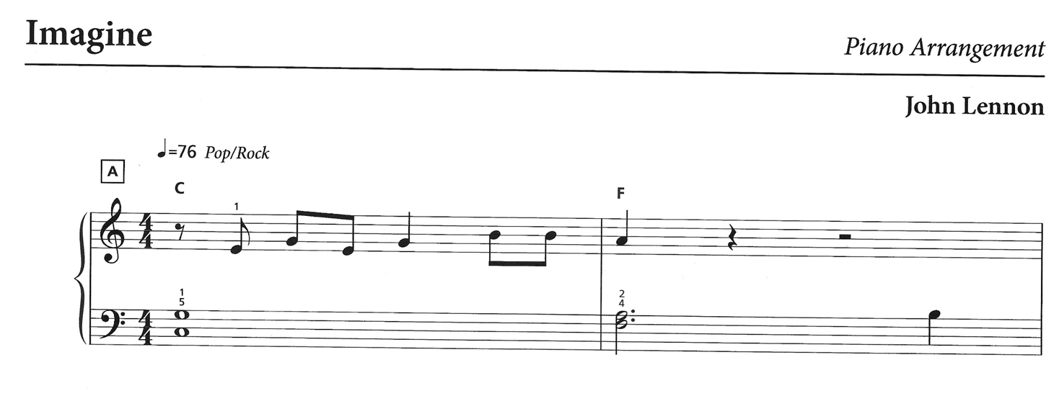
Overview
Grade 1 Course Content
You should be able to read and understand this
sheet music after only six lessons
Reading Notes - how long to hold each musical sound.
Reading the Staff - the name (pitch) of each note.
The Keyboard - how to find any note on a piano (or any musical keyboard).
Scales and Key Signatures
The C major, G major and F major scales. Understand key signatures and how sharps and flats define the key of a piece.
Types of Staff - the Treble and the Bass.
Intervals and Chords
Reading Staff Notation - dots, ties, slurs, rests and essential terms for tempo and dynamics.
Identify intervals and how to recognise chords.
Exam Qualification (optional)
Time Signatures
This course covers all topics in the Australian Music Examination Board (AMEB) Theory of Music Grade 1 exam. If you wish, you may take this exam online. The exam fee is paid directly to AMEB, who mark the exam and issue your certificate (65% pass mark).
Understand simple time signatures (including 4/4), and learn how beats are grouped in each bar.

Slide 3
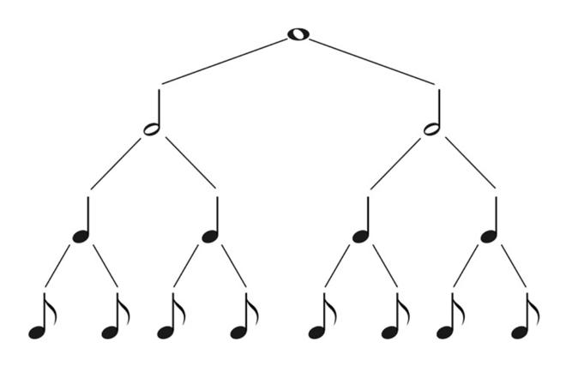
Notes
Lesson 1
Notes represent musical sounds. They have different shapes that tell us how long to play each note.
Each note has a name. This is an Australian course and uses British naming conventions (the US name is also shown below in brackets).
Semibreve (Whole Note) - played for 4 beats
Minim (Half Note) - played for 2 beats.
2 minims equal a semibreve.
Crotchet (Quarter Note) - played for 1 beat.
2 crotchets equal a minim. 4 crotchets equal a semibreve.
Quaver (Eighth Note) - played for ½ a beat.
2 quavers equal a crotchet. 4 quavers equal a minim. 8 quavers equal a semibreve.

Slide 4
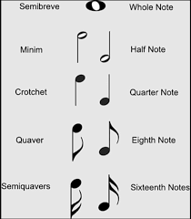
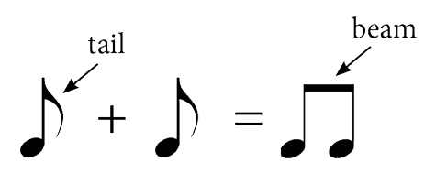
Note Stems
Semibreve
A Semibreve does not have a stem. Also note that it is an ellipse, not a circle.
Minim
Minims, Crotchets and Quavers have a stem.
If the stem goes down, it is always on the left.
If the stem goes up, it is always on the right.
Rules for when stems go up or down are provided in Lesson 2.
Crotchet
When it’s time to complete exercises in the Dulcie Holland Workbook
(refer to Slide 1),
it looks like this
Quavers have a tail. The tail is always on the right side of the stem, regardless of whether the stem goes up or down.
Quaver
Quaver
Quavers are often grouped together with
a beam in place of tails.
Complete
Exercises 1-23

Slide 5
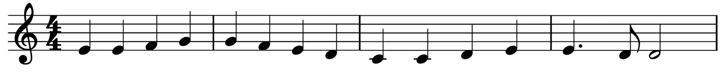
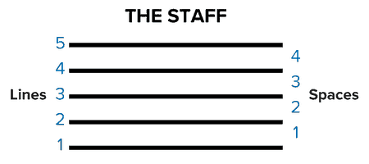
The Stave or Staff
Lesson 2
Notes also show the Pitch of sounds (how high or low they are) by their position on the Stave (also called the Staff).
The stave is a set of five lines with four spaces between them. These lines and spaces are numbered from the bottom up as follows:
For Example
The stave above shows 2 crotchets:
  The crotchet on the left is in the 1st space.
  The crotchet on the right is on the 2nd line.
The lower down on the stave the notes are written, the lower the sound.
The higher up on the stave they are written, the higher the sound.
If there is more than one Staff or Stave, the plural for both is Staves.
Complete
Exercises 1-2

Slide 6
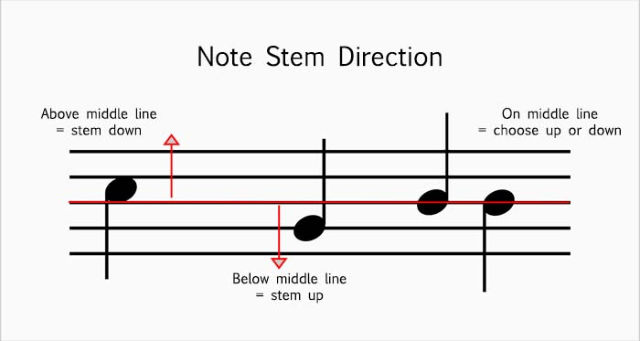
Complete
Exercises 3-14

Slide 7
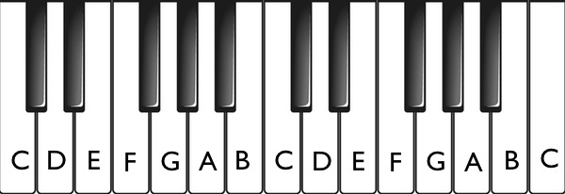
Treble Lines and Spaces
Lesson 3
Notes are given letter names: A, B, C, D, E, F and G. On a keyboard, these are the white notes.
These 7 white notes are repeated many times on a keyboard. Instead of starting at A, the pattern actually starts at C and then moves to the right D, E, F, G and loops around to A, B again (to finish the 7 notes). Below you can see this pattern repeated three times. Each repetition has been shaded a different colour to make this easier to see:

Slide 8
The black keys are grouped in two’s and three’s in an alternating pattern and we use this to find the white note that we are looking for:
  C is always just to the left of the group of two black keys.
  D is always between the two black keys.
  E is always to the right of the two black keys, etc.
Group of
2 black keys
Group of
3 black keys
Middle C
(the C nearest to the middle of the keyboard)
Treble notes
Bass notes
As we move up the keyboard, to the right of Middle C, the sounds become higher. These are the Treble notes.
Moving down the keyboard, to the left of Middle C, the sounds become lower. These are the Bass notes.
Middle C may be a Bass note or a Treble note.
Complete
Exercises 1-8

Slide 9
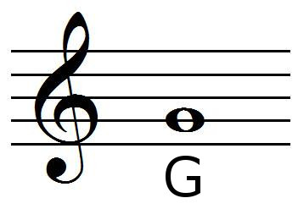
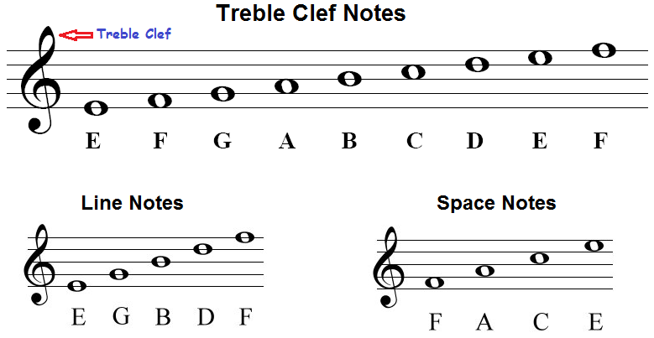
When writing Treble notes (those above middle C) on a stave,
we need a Treble Clef at the beginning of the stave.
Treble Clef Origin
In medieval and Renaissance notation, clefs were literally letters written on the staff to show where certain pitches were.
The treble clef began as a handwritten G.
Over time, scribes stylised and curved the letter until it became the symbol we use today.
The Treble clef, also known as the G clef, gives the name G to the second line of the stave (which it curls around). From this G, we can work out all of the other notes on the Treble stave.
Complete
Exercises 9-10

Slide 10
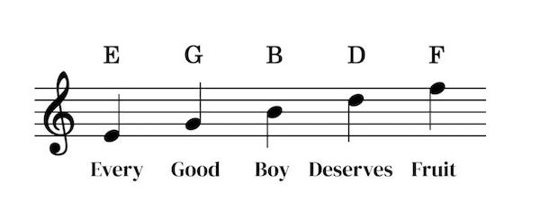
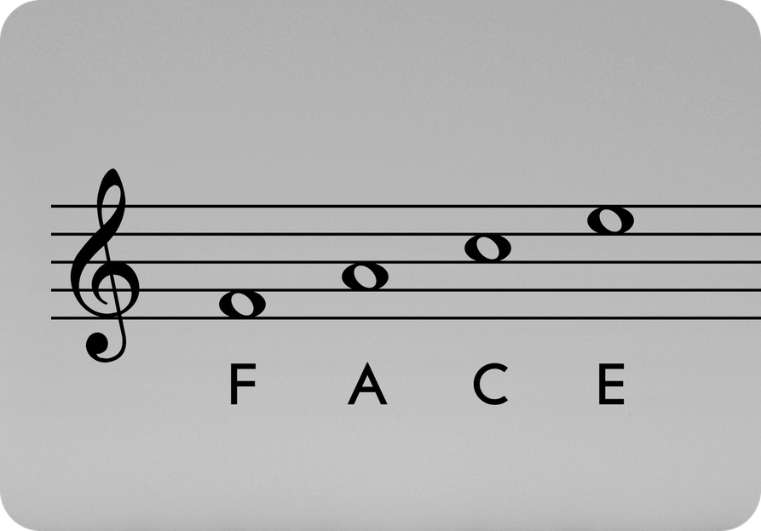
Recognising the name of each note on the treble stave is a fundamental skill that we need to learn.
To make this easier, here is an acronym for the notes on each line of the Treble stave:
The notes in each space of the Treble stave, make the word “FACE”:
Complete
Exercises 11-20

Slide 11
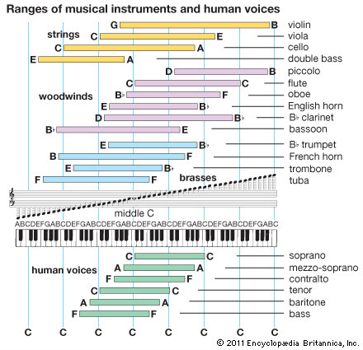
Not in exam
Here’s an interesting chart that shows which notes various instruments and human voices are capable of:
When you see a page with this label, it means the information on the page, while important, is not part of the Grade 1 Theory of Music AMEB exam.
Remember, any note above (to the right of) middle C is written on the treble stave.
Any note below (to the left of) middle C is written on the Bass Stave (discussed in the next lesson).
Piano Keyboard
88 Keys
Each repeating set of
C–D–E–F–G–A–B is one octave.
The piano spans just over seven octaves, giving it one of the widest ranges of any instrument.
Complete
Exercises 21-22

Slide 12
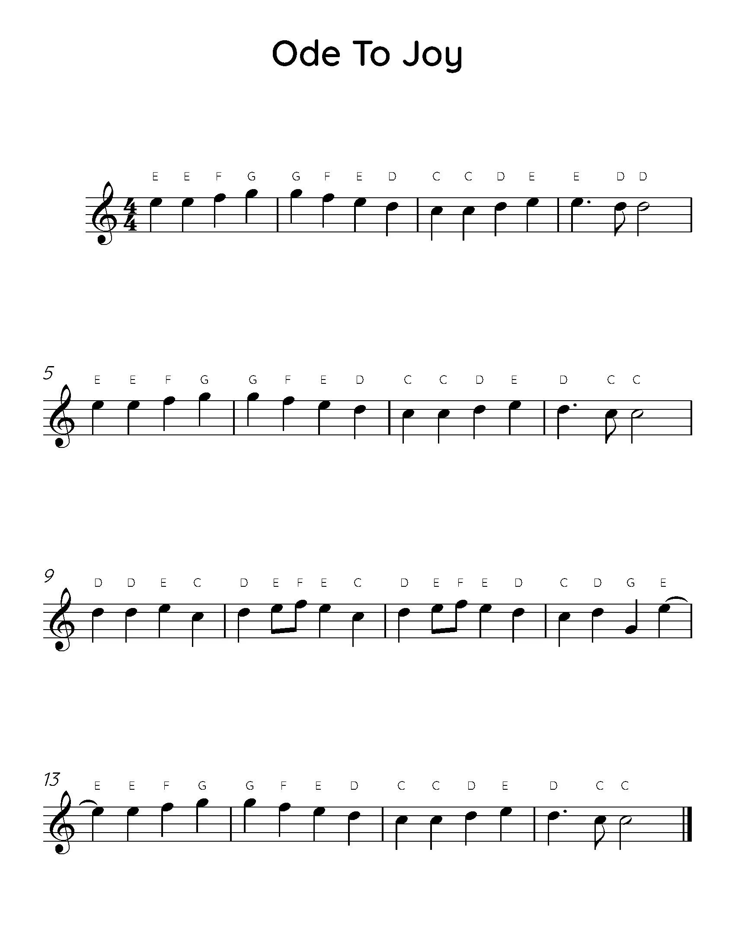
It’s time to put together everything that you’ve learned so far.
Below is the beginning of the famous “Ode to Joy” by Beethoven.
If you play an instrument, try playing it. Otherwise, try humming it.
All crotchets are played for 1 beat
The minim is played
for 2 beats
The crotchet with a dot after it is played for 1 and ½ beats
The quaver is played
for ½ a beat

Slide 13
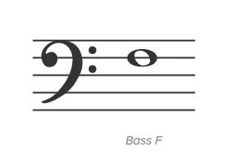
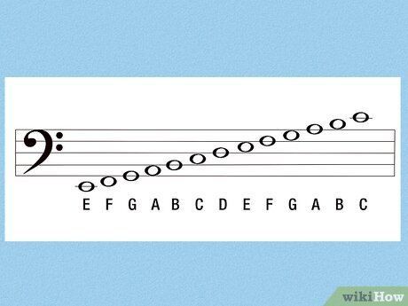
Bass Lines and Spaces
Lesson 4
When writing Bass notes (those below middle C) on a stave,
we need a Bass Clef at the beginning of the stave.
F
Bass Clef Origin
The bass clef began as a handwritten F.
Over time, scribes stylised and curved the letter until it became the symbol we use today.
The Bass clef, also known as the F clef, has two dots after it, one on each side of the 4th line of the stave, giving it the name of F. So the note on that line is F. From this F, we can work out all of the other notes on the Bass stave.
Complete
Exercises 1-2

Slide 14
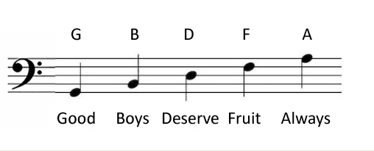
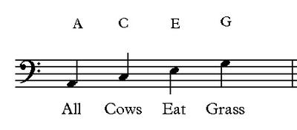
Recognising the name of each note on the bass stave is a fundamental skill that we need to learn.
To make this easier, here are acronyms for the notes on each line of the Bass stave:
or Good Birds Don’t Fly Away
And here is an acronym for the notes in each space of the Bass stave:
Complete
Exercises 3-24

Slide 15
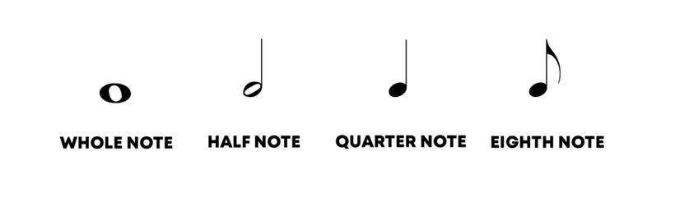
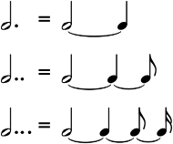
Dots, Ties and Slurs
Lesson 5
Dots
A dot after a note makes it half as long again. For example:
=
A minim equals two crotchets.
.
=
A dotted minim equals three crotchets (two for the minim plus half of two for the dot).
=
A minim equals four quavers.
.
=
A dotted minim equals six quavers (four for the minim plus half of four for the dot).
Ties
A tie is another way of making a sound last longer. It is a short curved line connecting one note to another of the same pitch. Only the first note is played and is held for the value of all the notes tied together. E.g.:
=
=
.
Complete
Exercises 1-12

Slide 16
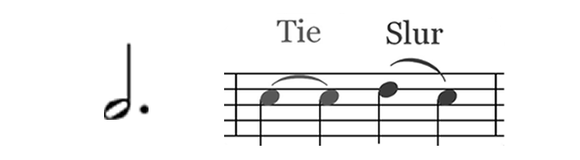
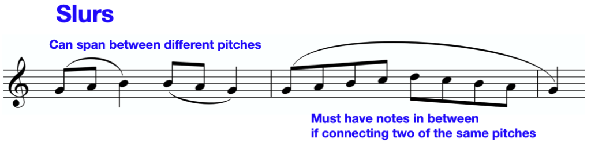
Slurs
A slur is a curved line that joins two or more notes to show that they are to be played legato (played with no perceptible separation, creating a continuous, flowing sound).
The notes may be adjacent, or there may be other notes between the first and last note; in either case, the slur applies to every note it covers. For example:
Ties vs Slurs
  Ties - connect two adjacent notes. They must be of the same pitch. It makes the first note last longer.
  Slurs - connect two or more notes. They must be a different pitch. Notes are played legato.
Do We Draw the Tie or Slur Above or Below the Notes?
  If the stems point up → the slur/tie goes below the notes.
  If the stems point down → the slur/tie goes above the notes.
You can see this in the two examples for slurs above (but the rule applies to ties as well).
Complete
Exercises 13-21

Slide 17
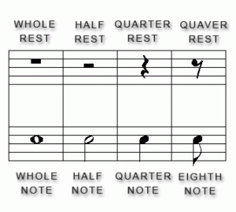
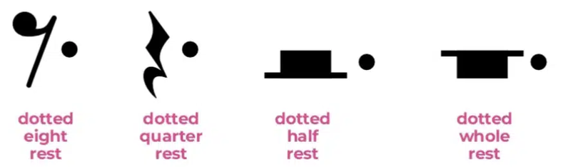
Rests and Leger Lines
Lesson 6
Rests
A Rest is a sign to show silence in music. It tells a musician when not to play.
The type of rest (and therefore how many beats of silence it represents) is shown by its shape and location on the stave as follows:
Semibreve Minim Crotchet Quaver
Rest Rest Rest Rest
(4 beats) (2 beats) (1 beat) (½ beat)
Rests are never tied. A rest can be dotted, for example:
Complete
Exercises 1-5
(6 beats) (3 beats) (1½ beats) (¾ beat)

Slide 18
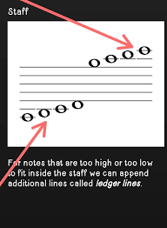
Leger Lines
Leger Lines are used for notes that are too high or too low to be written on a stave. They are short straight lines drawn parallel to the lines of the stave. They are long enough to take one note only. The spaces in between leger lines are also used. For example:
Complete
Exercises 6-7

Slide 19
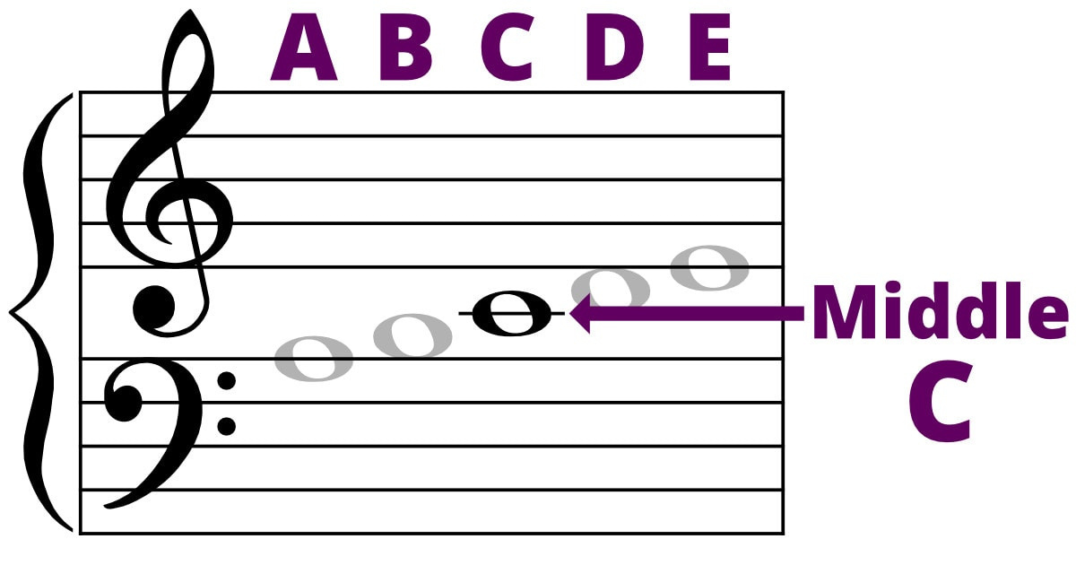
Middle C
As mentioned in Lession 3, Middle C may be a Bass note or a Treble note.
  On the Treble Stave - Middle C is shown on a leger line below the treble stave.
  On the Bass Stave - Middle C is shown on a leger line above the bass stave, as shown below:
Complete
Exercises 8

Slide 20
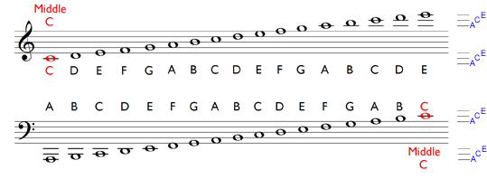
How to Remember Leger Line Notes
The word ACE describes the leger lines above and below both staves.
Complete
Exercises 9-17

Slide 21
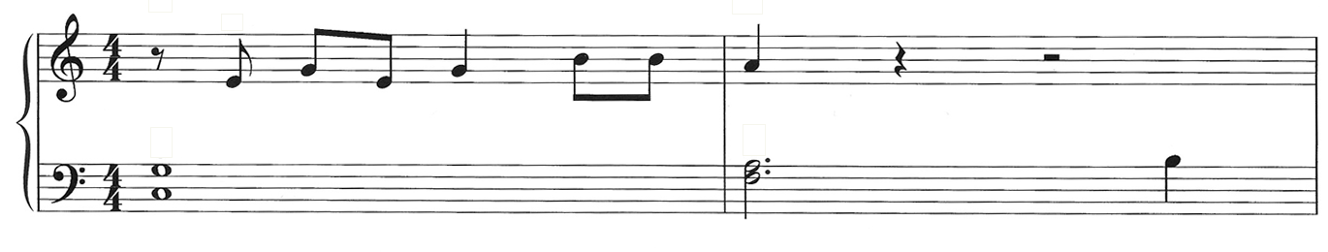
It’s time to put together everything that you’ve learned so far.
Below is the beginning of the famous “Imagine” by John Lennon.
If you play an instrument, try playing the Treble stave. Otherwise, try humming it.
Tempo - this is the pace that the song is played at in Beats Per Minute (BPM) - in this case 76 crotchet BPM (which is quite a slow song).
This is a time signature and tells us that there are 4 crotchet beats per bar. More on this later.
These are bar lines. Music is split into bars. This piece has two bars.
When you see a brace connecting the treble and bass staves, it means they belong to the same instrument and are played together. On the piano, the right hand plays the treble and the left hand plays the bass. The two staves combined are called the Grand Staff.
= 76
When notes are shown one above the other, they are played at the same time and are called chords.

Slide 22
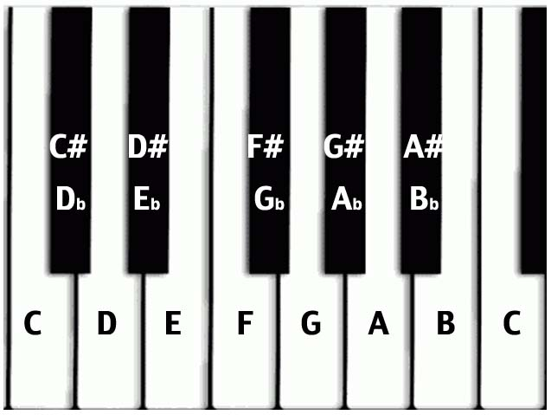
Semitones, Tones and Accidentals
Lesson 7
First, We Need to Name the Black Keys on the Keyboard - Every black key has two names:
For example - The black key between C and D is called C# (spoken as “C sharp”) and it is also called Db (spoken as “D flat”).

Slide 23
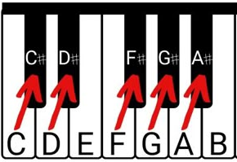
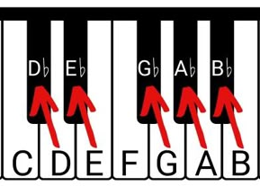
A Black key takes its name from the adjacent White key:
Sharps
Flats
A black key above a white key is called a sharp (written as #). E.g., C# is the key above C and is described as C sharp.
A black key below a white key is called a flat
(written as b). E.g., Db is the key below D and is described as D flat.
C# and Db are the same note.
Black keys need two names in a number of situations. We will cover the main one when we learn about Scales.

Slide 24
Not in exam
The Chromatic System
The word chromatic comes from an Ancient Greek word meaning “colour.” In music, it refers to using all 12 notes of the Chromatic System — the full set of pitches we have in Western music. When you use these notes one after another — especially the ones right next to each other — the sound becomes more “colourful” or expressive. The 12 notes repeat every octave.
Enharmonic
Two notes are enharmonic when they sound the same pitch but are spelled differently. E.g., C# and Db are enharmonic.
2 4 7 9 11 2
1 3 5 6 8 10 12 1

Slide 25
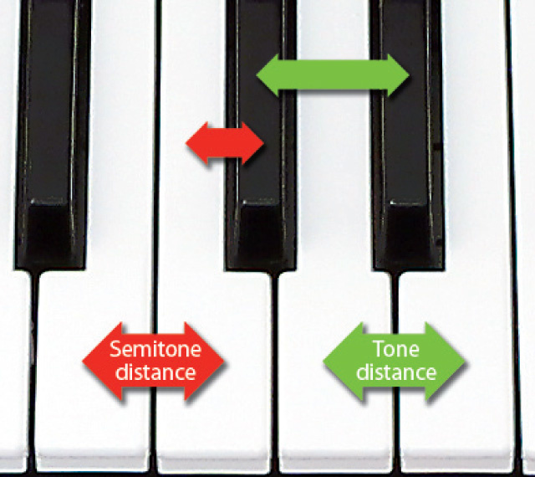
Now we know about black keys, we can describe Semitones and Tones:
C# D#
Semitone
Tone
Db Eb
A Semitone is the distance between any note and the note immediately above it or below it.
A Tone is equal to two Semitones (and therefore the distance between any Tone is two notes).
B C D E
Complete
Exercises 1-5

Slide 26
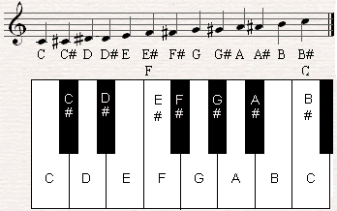
Accidentals
When describing the black key between the keys C and D, we might say or write “C sharp” or “C#” (or “D flat” or “Db”).
On a staff the “#” or “b” is written before the note - this is called an Accidental.
Let’s look at Sharps first:
Sharps
F
C
A Sharp (symbol “#”) raises a note by a semitone. E.g., C sharp is a semitone above C.
Complete
Exercises 6-9

Slide 27
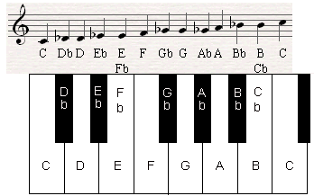
Accidentals (continued)
Flats
A Flat (symbol “b”) lowers a note by a semitone. E.g., D flat is a semitone below D.
On a staff the “b” is written before the note and is also called an Accidental.
E
B
Complete
Exercises 10-13

Slide 28

Not in exam
Accidentals (continued)
A case that you should be aware of, but will rarely come across: between E and F there is no black note. Therefore, F is one semitone above E and so can be referred to as E#. Similarly, E is one semitone below F and can therefore be referred to as Fb. It’s the same between B and C.
Be aware of it, and now forget about it :) You are unlikely to come across this until higher music theory grades.

Slide 29
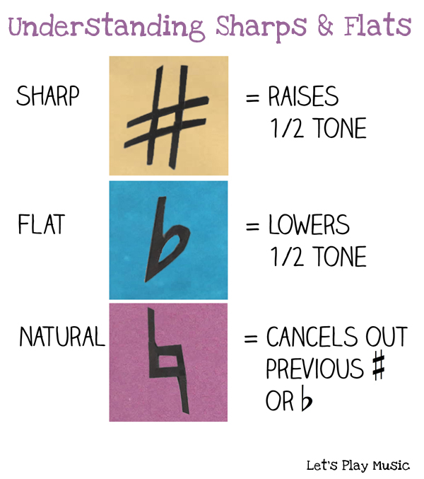
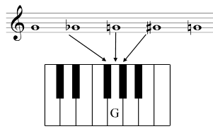
Types of Accidental
An Accidental applies only to notes in that bar that are
on the same line or in the same space. It lasts until the end of the bar or until replaced by another Accidental.
Gb G#
Complete
Exercises 14-17

Slide 30
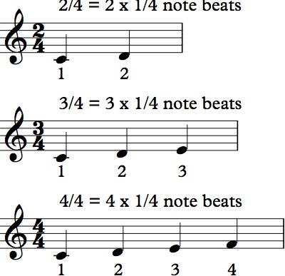
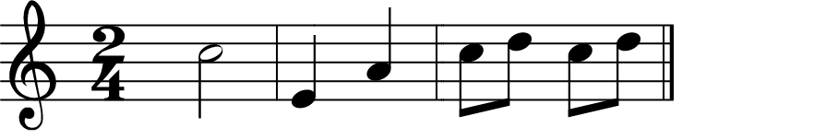
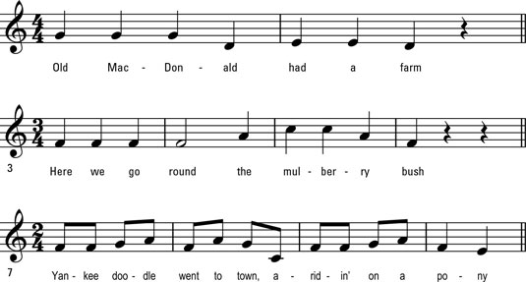
Simple Duple Time (2/4)
Lesson 8
Of course, you can use any notes that are the equivalent of two crotchets:
The top number shows the number of beats per bar.
Two Crotchets
The bottom number shows the type of note making up each beat
(4 = crotchet).
One Minim Four Quavers
... are all valid.
NB: You’ll never see a Semibreve in 2/4 time as it won’t fit.
This is a Time Signature and the
Time Signature 2/4 means
2 x crotchet beats per bar
Bar Lines divide music into Measures. Notes are grouped according to the time signature to show the beats per bar clearly. The example above shows three bars. The music below is divided into four bars.
A Classical Example of music in 2/4 time is:
William Tell Overture
Gioachino Rossini
(Lone Ranger Theme)
Bar 1
Bar 2
Bar 3
Bar 4

Slide 31
Rhythm in 2/4 Time
A beat is the steady pulse of the music - like a musical heartbeat. If you tap your foot along to a song, you’re tapping the beats.
Not every beat feels the same. Some beats feel like they arrive (strong beats), and others feel like they’re leading you to the next beat (weak beats). This isn’t about the volume of the beat — it’s about the natural feeling of the music. Think of breathing:
  Inhale = strong beat (the moment of gathering energy).
  Exhale = weak beat (the release that leads you to the next breath).
2/4 = 2 x crotchet beats
Counting Beats
The first beat of any bar is called the downbeat and is a strong beat. This can be shown with a “>” symbol.
> >
2/4 = 1 2 | 1 2
How to Clap Beats
Stomp your foot on the strong beat and clap your hands on the weak beat.
Complete
Exercises 1-3

Slide 32


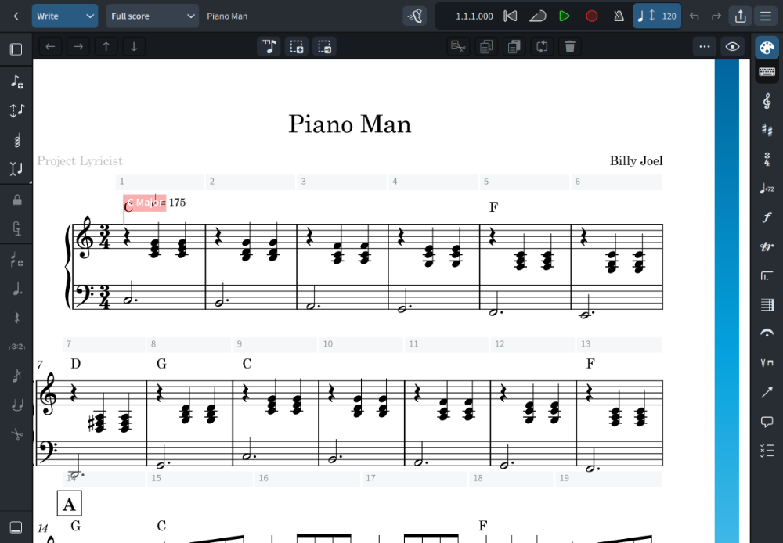
Simple Triple Time (3/4)
The Time Signature 3/4 means 3 x crotchet beats per bar. For example:
Nursey Rhyme Example
Rests in ¾ Time
Best practice is to use two crotchet rests (instead of a minim rest) so that
the rest does not “hide” where the beats occur.
This rule only applies to rests - it is fine to use minim notes or dotted minim notes in ¾ time.
Notes can cross beats, but rests must show the beats clearly.
Classical Example
Blue Danube
Johann Strauss II
(Waltz)
Pop Example
Piano Man
Billy Joel

Slide 33
Rhythm in 3/4 Time
When counting Rhythm in 3/4 time, simply think of a Waltz:
Counting Beats
3/4 = 3 x crotchet beats
> >
3/4 = 1 2 3 | 1 2 3
Strong weak weak | Strong weak weak
How to Clap Beats
Stomp your foot on the strong beat and clap your hands on the weak beat.
Complete
Exercises 4-17

Slide 34
Semibreves & Semibreve Rests
In lesson 6 we learned about semibreve rests:
Semibreve Minim Crotchet Quaver
Rest Rest Rest Rest
(4 beats) (2 beats) (1 beat) (½ beat)
Semibreves are not used in 2/4 or 3/4 time because they don’t fit. A semibreve is a note that is played for 4 beats, and this won’t fit into a bar which only has 2 or 3 beats.
Semibreve Rests can be used in 2/4 or 3/4 time, but when they are, their meaning changes to “rest for the entire bar”. This is done to maintain readability. It is easier to see a Semibreve rest and know that it applies to the entire bar, rather than cluttering the notation with multiple rests.

Slide 35
Simple Quadruple Time (4/4)
Lesson 9
The Time Signature 4/4 means 4 x crotchet beats per bar. For example:
Nursey Rhyme Example
A Double Bar with a thin and thick line shows the end of a song.
Classical Example
Ode to Joy
Beethoven
Pop Example
Imagine
John Lennon

Slide 36
Rhythm in 4/4 Time
Meter
and the
Hierarchy of Beats
Counting Rhythm in 4/4 time:
Meter is the repeating pattern of strong and weak beats in music.
Within this pattern, beats have different levels of strength — some are strong, some medium, some weak. This is called the hierarchy of beats. It’s a core concept worth introducing early, even though developing the physical control to express these differences on an instrument is an advanced skill.
Counting Beats
4/4 = 4 x crotchet beats
> - > -
4/4 = 1 2 3 4 | 1 2 3 4
In 4/4 time the 3rd beat is a Medium beat shown with a “-” symbol
How to Clap Beats
Stomp your foot on the strong beat and clap your hands on the weak beat.
Simple Time Signatures
2/4 is also called Simple Duple Time, 3/4 is Simple Triple Time and 4/4 is Simple Quadruple Time. Why Simple? Because each beat can be split evenly into two shorter beats. I.e., each beat is a crotchet and each crotchet can be split evenly into two quavers. Simple :)
Complete
Exercises 1-8

Slide 37

The Anacrusis
An Anacrusis is a note - or group of notes - before the first complete bar.
The last beat of a bar is called the Upbeat.
In the example below, the anacrusis includes the upbeat (this is usually the case).
It is also possible for an anacrusis to contain more notes than just the upbeat (Refer to the example on the next page).
Origin
The word anacrusis comes from an ancient Greek word that means "pushing back" or "drawing back."
Think of a warrior pulling back an arrow before shooting, or an athlete pulling back their foot before kicking a soccer ball.
In music, it means the light, unstressed note(s) that prepare your ears for the first strong beat.
Refer to the example on the next page.
Bar 1
The note value of the anacrusis is usually subtracted from the final bar of the piece.
In this example:
  the Anacrusis crotchet = 1 crotchet beat
  plus the final bar minim = 2 crotchet beats
equals 3 crotchet beats
3 crotchet beats is correct for one bar of 3/4 time.
Anacrusis

Slide 38
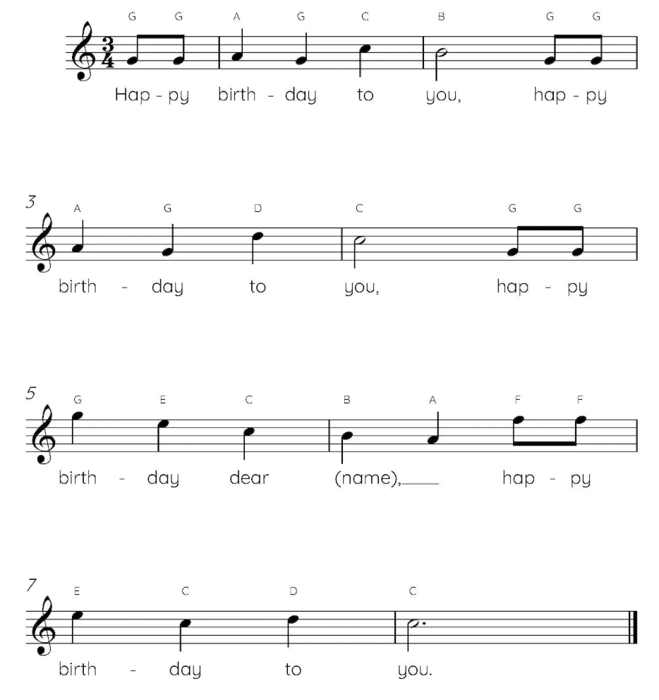
While an anacrusis usually occurs at the very start of a piece ...
... an anacrusis can also appear inside a song to kick off a new musical phrase.
Not in exam
1. Spoken Stress
If you say "Happy Birthday to you" naturally, it sounds like this:
  "happy BIRTH-day to you"
You do not say:
  "HAP-py birthday to you" (This sounds like you are ordering someone to be happy).
2. Musical Alignment
Because "Birth" is the most important syllable, the music places it on the downbeat (Beat 1) of the first full measure.
The two syllables of “Happy” form the anacrusis. They are the unstressed lead‑in that propels you into the strong beat:
  Beat 3 (anacrusis/upbeat): Hap‑
  Beat & (anacrusis): ‑py
  Beat 1 (downbeat): BIRTH‑
  Beat 2: ‑day
3 & 1 & 2 & 3 & 1 & 2 & 3 &
The anacrusis that appears before Bar 1 still has its value subtracted from the final bar of the piece.
Complete
Exercises 9-15

Slide 39
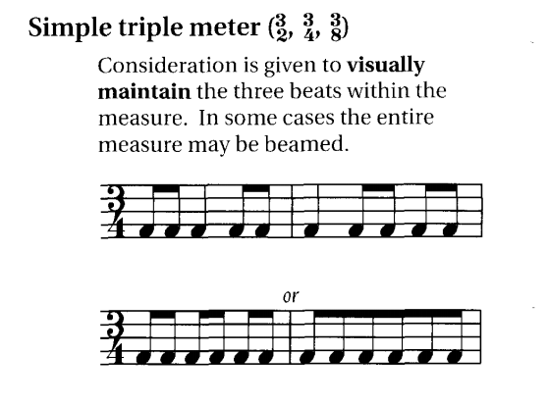
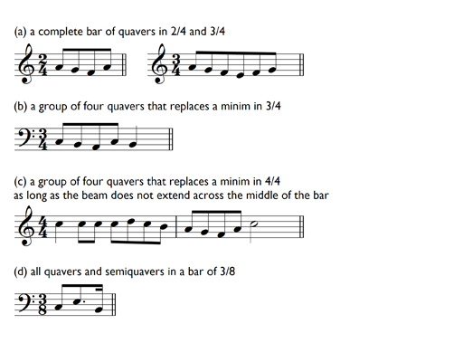
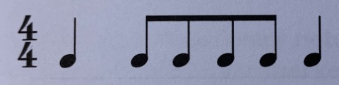
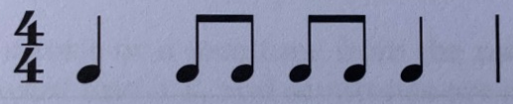
Grouping of Notes and Rests
Lesson 10
Notes and rests need to be grouped to show where the beats come in the bar.
As we know, in simple time, each beat may be divided into two equal parts. So quavers are often grouped in two’s to show where the beats fall. For example:
1 2 3
In 2/4 time, we occasionally find quavers in groups of 4:
In 3/4 time, we occasionally find quavers in groups of 6:
In 4/4 time, quavers may be grouped in fours covering the 1st and 2nd beats, or the 3rd and 4th beats, but never the 2nd and 3rd beats. The first note of a group of quavers must be on a strong or medium beat.
Complete
Exercises 1-5
1 2 3 4
1 2 3 4

Slide 40
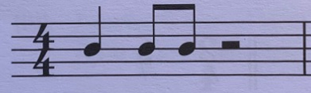

Minim rests may be used in 4/4 time covering the 1st and 2nd beats, or the 3rd and 4th beats. Minim rests may never cover the 2nd and 3rd beats in 4/4 time:
1 2 3 4
1 2 3 4
Minim rests are not used in 3/4 time. Best practice is to use two crotchet rests (instead of a minim rest) so that the rest does not “hide” where the beats are:
1 2 3
1 2 3
Complete
Exercises 6-10

Slide 41

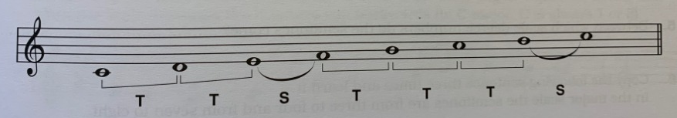
C Major Scale
Lesson 11
White keys only. There are no sharps or flats in the C Major scale.
or 1
1 2 3 4 5 6 7 8
Scale Degree Numbers
The Major Scale is the most common type of Scale and all Major Scales use the same interval pattern of Tones and Semitones:
T - T - S - T - T - T - S
Complete
Exercises 1-20

Slide 42
Why do we have Scales?
Melodies are created by choosing notes from a scale and arranging them in meaningful ways. If you’re writing or playing a tune in C major, you’re mostly using the notes of the C major scale. This is why scales are described as the building blocks of music.
All of these notes are in the scale of C Major.
E G E G B B A
Imagine
John Lennon
C Major
Diatonic
A Diatonic scale is a seven‑note scale built from a mix of Tones and Semitones in a fixed pattern. Major scales use the fixed pattern T - T - S - T - T - T - S and are therefore Diatonic. The word Diatonic comes from Ancient Greek and means “through the tones” or “stretched through the notes.”

Slide 43
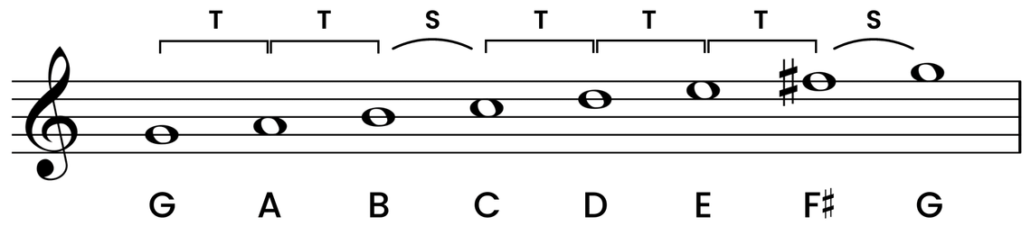
G Major Scale
Lesson 12
G Major is a Major Scale and therefore uses the same interval pattern of Tones and Semitones as C Major (as they are both Major Scales):
T - T - S - T - T - T - S
Any major scale that does not start on C needs at least one sharp or flat so it can follow the
correct pattern of tones and semitones.
7
From E to F is a Semitone and the pattern requires a Tone. E to F# is a Tone and therefore will
sound correct
when the scale is played.
or 1
1 2 3 4 5 6 8

Slide 44
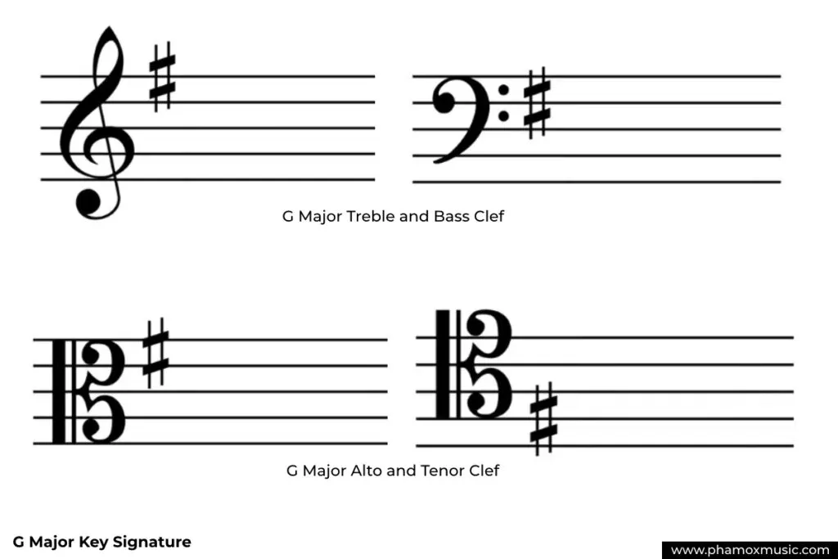
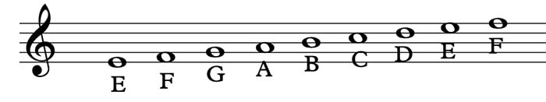
A Key Signature
Rather than write the # in front of the F each time, it is written at the beginning of the stave and
is called a Key Signature.
Fifth line
of theTreble
(the top F)
Fourth line
of the Bass
(the top F)
Remember that there is no F note in the G Major Scale, only an F#. Therefore, this Key Signature applies to all F lines and spaces on the staff (including F Leger Lines). In the scale of G Major, when the note F is shown, it is assumed to have a # in front of it. That is the power of a Key Signature.
Written as “O”, read as “#O”

Slide 45


Why Have Different Scales?
Not in exam
There are many reasons why a composer might select a particular scale for, such as the mood they are trying to convey. Some scales are easier to play on a particular instrument. For example, G Major is slightly easier to play on a guitar than C major because of the shape of the hands when playing the notes.
But in this example, we’ll look at how a song sounds when you sing it. Shifting a melody from C major to G major raises the pitch of the entire song, and may place the melody in a more comfortable singing range for many voices.
Let’s sing the Chorus to two Beatles songs that use the major scale:
Let it Be is in C Major (we know this because there is no Key Signature).
All You Need is Love is in the key of G Major (note the key signature on the treble clef).
Sing “All you need is love”. You’ll notice that it is sung in a higher pitch than Let It Be.
Complete
Exercises 1-9

Slide 46

F Major Scale
F Major is a Major Scale and therefore uses the same interval pattern of Tones and Semitones as C Major and G Major:
T - T - S - T - T - T - S
Any major scale that does not start on C needs at least one sharp or flat so it can follow the
correct pattern of tones and semitones.
Why Bb and not A#?
4
A major scale must use each letter name once, in order, and Bb is the only spelling that keeps the scale correctly organized.
F-G-A-Bb-C-D-E-F
From A to B is a Tone and the pattern requires a Semitone.
A to Bb is a Semitone and therefore will sound correct
when the scale is played.
or 1
1 2 3 5 6 7 8
Complete
Exercises 10-21

Slide 47


Key Signature for F Major
Rather than write the “b” in front of the B each time, it is written as a Key Signature.
On the B line
(third line of the Treble)
On the B line
(second line of the Bass)
Remember that there is no B note in the F Major Scale, only a Bb.
Therefore, this Key Signature applies to all B lines and spaces on the staff (including B Leger Lines).
Below is the melody of Yesterday by The Beatles. Here, the artists chose F Major for the song and then used a natural accidental to change the first Bb to a B and to change the next note, D, to a Db. They effectively used notes outside the F Major scale in order to obtain the sound they wanted. The Beatles couldn’t read or write music notation (they just played what sounded right to them). However, this is a valid and normal use of accidentals.

Slide 48


Intervals
Lesson 13
An Interval describes the distance between two notes.
Count the letter names from the bottom note through to the top note (including themselves) to find the name of the interval:
  C to D is a second (two notes C and D)
  C to E is a third (three notes C, D and E)
  C to F is a fourth (four notes C, D, E and F)
  C to G is a fifth (five notes C, D, E, F and G), etc
Unison is an interval because it describes the distance between two notes. Even though one instrument can’t play the same pitch twice, multiple instruments can. Music theory needs a name for that distance, so we call it unison.
An octave (interval of 8 notes) can also be written as 8ve.
Complete
Exercises 1-5

Slide 49
When we learned the C Major scale (Lesson 11), we learned that a Diatonic scale is a seven‑note scale built from a mix of Tones and Semitones in a fixed pattern. Major scales use the fixed pattern T - T - S - T - T - T - S and are therefore Diatonic.
All of the intervals above have C as their bottom note, and they all use the notes of the C Major scale for their top note. Therefore, they are called Diatonic Intervals.
If the top note is not in the scale of the bottom note then it is a Chromatic Interval. For example, C to F# (F# is not in the C Major scale and so the interval is chromatic).
Complete
Exercises 6-20

Slide 50


Tonic Triads
Lesson 14
A Chord is defined as two or more notes played at the same time. It gives a richer sound than playing a single note.
For example, in the C Major scale:
Assuming the C note played is middle C, then the chord looks like this on the treble stave.
Root 3rd 5th
Triad
Study the pattern the 3 notes make on the stave. All Triads form this pattern making them easy to recognise. This triad has all the notes on lines. Some triads have all the notes in the spaces, but the pattern remains the same for all triads.
A Triad is a chord of three notes. It consists of a Root note with two other notes at the interval of a third and a fifth above the root.
A triad can be built starting on any note, but the one we use most in a key is the triad built on the Tonic — the first note of the scale.
So in the C major scale, the Tonic Triad is a C major chord. We will define a major chord later on.
Complete
Exercises 1-4

Slide 51


The Tonic Triad for the G Major scale is the G Major chord:
The Tonic Triad for the F Major scale is the F Major chord:
Root 3rd 5th
Root 3rd 5th
Triad
Triad
Complete
Exercises 5-10

Slide 52

Revision
Complete
Exercises 11-20

Slide 53


The Triads in a Major Scale
Not in exam
In every major scale, you can build a triad (a 3‑note chord) starting on each note of the scale. Each triad uses only the notes from the scale. In C major, the notes are: C – D – E – F – G – A – B
How to Play
Play C major as shown above.
Now, without changing the shape of your hand, move up one note and play D minor. Continue moving up the keyboard, one note at a time, and play all 7 chords.
You can build a triad on every note of the C major scale. All of these chords use only white notes because C major has no sharps or flats.
These 7 chords are the building blocks of thousands of songs.

Slide 54
Major and Minor Triads
Not in exam
  Major chords sound happy.
  Minor chords sound sad.
The number of semitones between the notes, determine whether a triad is major or minor.
C Major Triad (notes C-E-G)
D minor Triad (notes D-F-A)
1 2 3 4 1 2 3
1 2 3 1 2 3 4
E is 4 semitones above C
(also called a major 3rd)
F is 3 semitones above D
(also called a minor 3rd)
A is 4 semitones above F
(also called a major 3rd)
G is 3 semitones above E
(also called a minor 3rd)
All major triads use this pattern of:
4 semitones, then 3 semitones.
All minor triads use this pattern of:
3 semitones, then 4 semitones.

Slide 55
Diminished Triad
Not in exam
Diminished triads sound tense. A diminished triad is written with a degree symbol. For example, the 7th chord in the C Major scale is B diminished which is written as B°.
The number of semitones between the notes, determine whether a triad is diminished.
B Diminished Triad (notes B-D-F)
1 2 3 1 2 3
D is 3 semitones above B
(also called a minor 3rd)
F is 3 semitones above D
(also called a minor 3rd)
All diminished triads use this pattern of:
3 semitones, then 3 semitones.

Slide 56

Real Life Example
Not in exam
Here are the first 16 bars of the Beatles’ song Let It Be. The chords have been simplified so there is nothing that you haven’t already learned. They are all played with the right hand on a piano.
Intro
1
Verse 1
= 72
Chorus
When I find myself in tiimes of trouble And in my hour of darkness she is
Mother Mary comes to me Speaking words of wisdom
Let it be
standing right in front of me Let it be Leit it be Let it be Let it be Whisper words of wisdom Let it be
Speaking words of wisdom
Let it be
This might look a little scary at first glance, but we’ll break it down on the next page.
A Melody is a sequence of single notes played one after another that forms a musical line. It is usually the part of the music you can hum or sing. In Let It Be, the melody is sung by Paul McCartney and the lyrics appear above.
Harmony is what happens when two or more notes sound at the same time. It creates the sense of depth or richness beneath a melody using chord progressions (a series of chords). The Harmony is played on the piano using the chords above.

Slide 57
Step 1 - Identify Repetition
Bars 1-4 are the same as bars 5-8, which are the same as bars 9-12. So by learning how to play bars 1-4, we also learn how to play the first 12 bars. So let’s focus on the first repetition (bars 1-4).
Not in exam
Intro
1
Verse 1
= 72
Chorus
When I find myself in tiimes of trouble And in my hour of darkness she is
Mother Mary comes to me Speaking words of wisdom
Let it be
standing right in front of me Let it be Leit it be Let it be Let it be Whisper words of wisdom Let it be
Speaking words of wisdom
Let it be
Step 2 - Identify Chords
Note the chords being used in the repeated section (bars 1-4).
C G Am F C G F Em Dm C

Slide 58
Not in exam
C G Am F C G F Em Dm C
Bars 1-4 are simply repeated here for reference
Step 3 - Break it Down and Practice Slowly
If you are experienced at playing these chords, take the first 2 bars and practice those on repeat. Once you can move confidently between those chords, move to the next 2 bars.
However, if you are a piano beginner:
  Start by locating the first chord (C Major) on the keyboard. NB: It is not middle C, it is the next C to the right (one octave up).
  Using your right hand, place your thumb on C, middle finger on E and little finger on G.
  Play these three notes simultaneously and continue playing for 2 beats, then play it again and hold for 2 more beats. Become comfortable doing this before moving on.
  The next chord is G major and it is below the C on the stave, so you move your hand to the left until you find G. Maintain the same hand shape that you used for C and when your thumb is over G, your middle finger should be over B and your little finger should be over D. Play this chord for 2 beats, and keep playing it until you’re comfortable with it.
  Now comes the tricky part. We need to learn to move between the chords C major and G major. Start slowly. Play C for 2 beats, then move to G and play it for 2 beats. Then move back to C and repeat until you are comfortable.
  Now we’ll practice bar 2, which has A minor (Am) and F major (F). Am is A-C-E and F is F-A-C. So, to find Am when you are on G, you move your entire hand one note to the right. And to find F when you are on Am, move your entire hand two notes to the left. Practice bar 2 until you are comfortable.
  Now try playing bars 1 and 2 together: Start on C, move left to G, move right to Am, move left to F. Repeat.
  Keep practicing as slowly and as much as you need to in order to create muscle memory for moving between chords.
Congratulations - you’ve played your first chord progression!

Slide 59

Not in exam
The Chord Sheet
If you’re playing classical music, you’ll usually see everything written out on traditional music staves.
However, in contemporary styles there is another type of notation you should be aware of.
Chord sheets are very common in modern music because many styles are built around chord progressions rather than fully written‑out melodies or arrangements.
On the right is a chord sheet for Let It Be, showing the first 16 bars. You’ll see that the chords are the same ones, in the same order, but there is no direction on how long to play each.
Comparing the two systems:
  Traditional notation tells you exactly what to play and when to play it. It is a musical recipe for the musician to follow.
  Chord sheets give you the chords and lets you decide how to play them.

Slide 60
Sight-Reading
Not in exam
Sight‑reading means playing music the first time you see it, keeping the beat steady and following the notation in real time.
It’s about reading and playing at the same time, without stopping.
When Do Musicians Use Sight‑Reading?
  Music lessons — teachers check how well you can read new music
  Exams — most exam boards include a sight‑reading test
  Rehearsals — ensembles often try new pieces on the spot
  Accompanying — pianists frequently sight‑read for singers or instrumentalists
  Learning new pieces quickly — helps you explore music without memorising it first
How Do I Learn to Sight‑Read?
So far we’ve learned the basics of the musical “alphabet”. To be able to sight-read you need to recognise words (chord patterns) and sentences (musical phrases in bars), at a glance. In the same way you can read English from a book.
Everything you’ve learned so far provides the basic building blocks of sight-reading. Most musicians with formal training can sight‑read at some level. It’s a standard part of classical education and ensemble playing. But being able to pick up any piece of music and play it from the notation is a skill that takes years of practice to master. Just like English.
Many amateur musicians can only sight-read at a basic level, and learning it is not compulsory. Many people who enjoy music theory never learn to sight-read. And that’s okay. But now you know this skill exists, and have the option to learn it.

Slide 61

Transposition
Lesson 15
Transposing music means changing it to a higher or lower pitch without altering its shape or any of its intervals.
This is often done if a song is too high or too low for a singer to reach all of the notes. By transposing, the song sounds very very similar, but the singer won’t strain their voice.
The average person can’t tell the difference if a song is transposed by a few semitones.
Here is a simple example of transposing from F Major up to G Major (all the notes are moved up 2 semitones - from F to F# is 1 semitone, then from F# to G is another semitone). However, on the stave you only move up one position (from a space to the line above, or from a line to the space above).
Method:
1. Locate the tonic note F. In the example below this is the first note.
2. We are transposing up to a higher pitch so locate the first G above the F (it is on the line just above the F). Therefore the interval between F Major and G Major is one position.
3. Move all the notes shown in the F Major song up one position to transpose it to G Major.
Before
After
Complete
Exercises 1-7

Slide 62
Revision
Complete
Exercises 8-13

Slide 63

Terms and Signs
Lesson 16
Many present-day forms of music took shape in Italy, so we use many Italian terms and their abbreviations to show how music is to be played.
Terms for Volume of Sound
Complete
Exercises 1-4

Slide 64

Terms for Speed/Tempo
* Remember that Tempo means speed and is measured in Beats Per Minute (BPM)
Complete
Exercises 5

Slide 65


Examples - Volume of Sound Terms
Andante
Complete
Exercises 6-7

Slide 66


Terms for Speed/Tempo (continued)
Starts Andante (easy walking pace, say 80 BPM), then gradually slows during the 4th bar, then returns to Andante at the start of bar 5.
Complete
Exercises 8-9

Slide 67


Terms for Touch
All of these terms add character and feeling to musical performances. They are mostly applied in classical music.
Complete
Exercises 10-13

Slide 68

Congratulations!
You’ve reached the end of Grade 1
You now have the option of taking the exam and earning a certificate (refer to the next slide) or you can purchase the Grade 2 workbooks from Amazon. My intention is to extend these slides to cover
Grade 2 in due course.
Download These Slides From:
www.DaveBStevens.com/music-theory

Slide 69



Exam Qualification
(optional)
This course covers all topics in the:
Australian Music Examination Board (AMEB)
Theory of Music Grade 1
If you wish, you may take this exam online. The exam fee is paid directly to AMEB, who mark the exam and issue your certificate (65% pass mark).
You can take as many online practice exams as you like before taking the actual test.
https://www.ameb.edu.au/exams/music/music-theory

